Slide 1

PROJECT REPORT
ON
INVENTORY MANAGEMENT SYSTEM
Submitted
In Partial Fulfillment of the Requirements for the Degree Of
Master of Science
[Computer Applications & Information Technology]-VI
SUBMITTED TO :-
DEPARTMENT OF COMPUTER SCIENCE,
HEMCHANDRACHARYA NORTH GUJARAT UNIVERSITY,PATAN
SUBMITED BY :-
NAME ROLL NO EXAM NO
(1) MODI TANISH RAMESHKUMAR 72 125
(2) MODI TEJASV MAHESHKUMAR 74 127
GUIDE BY:-
Dr BHAVESH M PATEL
Dr NIMESH I MODI

Slide 2

PROJECT PROFILE
PROJECT PROFILE
Project Title | INVENTORY MANAGEMENT SYSTEM
Project Objective | inventory management is to help businesses easily and efficiently manage the ordering, stocking, storing, and using of inventory.
Types Of Application | PHP
Front-End Tools | VS CODE, Notepad ++
Back-End Tools | MYSQL DATABASE
Internal Guide | PROF BHAVESH M PATEL PROF NIMESH I MODI
Time Duration | 6 Months
Submitted To | Department Of Computer Science (HNGU).

Slide 3
Project Definition
Project Title : Inventory Management
Inventory management is the supervision of noncapitalized assets -- or inventory -- and stock items. As a component of inventory management supervises the flow of goods from manufacturers to warehouses and from these facilities to point of sale. A key function of inventory management is to keep a detailed record of each new or returned product as it enters or leaves a warehouse or point of sale.
Organizations from small to large businesses can make use of inventory management to track their flow of goods. There are numerous inventory management techniques, and using the right one can lead to providing the correct goods at the correct amount, place and time.
Inventory control is a separate area of inventory management that is concerned with minimizing the total cost of inventory, while maximizing the ability to provide customers with products in a timely manner. In some countries, the two terms are used synonymously.

Slide 4
Hardware & Software Configuration
Software Requirements:-
OPERATING SYSTEM : | Windows
FRONT END : | Html5, CSS3, Javascript
BACK END : | My Sql
BROWSER : | Crome, Opera And Any Mordern Browser
Hardware Requirements :-
PROCESSOR : | Intel I3 1.0 GHz or Higher
RAM : | 256 MB or Updated
Hard Disk : | 20 Up to 160 GB or Higher

Slide 5
Requirement Analysis
The project aims to develop an Inventory Management System that will facilitate efficient tracking, monitoring, and control of inventory for a business. The system will provide functionalities for inventory management, stock tracking, order fulfillment, and reporting to optimize inventory levels, streamline operations, and improve overall efficiency.
Implement features for managing supplier information, purchase orders, and automated order placement.
Product Categorization
Product Measurement
Stock Inquiries
Automatic Stock-out Reports
Managed Inventory
E-commerce
Design a user-friendly interface that is intuitive and easy to navigate, allowing users to interact with the system efficiently.

Slide 6
MODULES
ADMIN
2. USER

Slide 7
Admin Module
Login
Insert Category
Manage Category
Insert Sub Category
Manage Sub Category
Manage Brand
Insert Brand
Insert new Product
Manage Product
Manage Order
Manage Users
Logout

Slide 8
User Module
View sub-Category
View Product
Registration & Login
Order Product

Slide 9
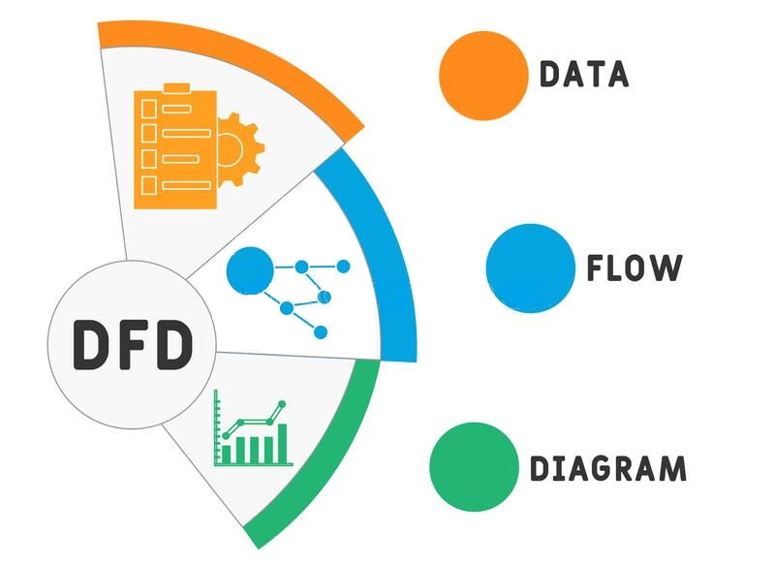
DFD

Slide 10
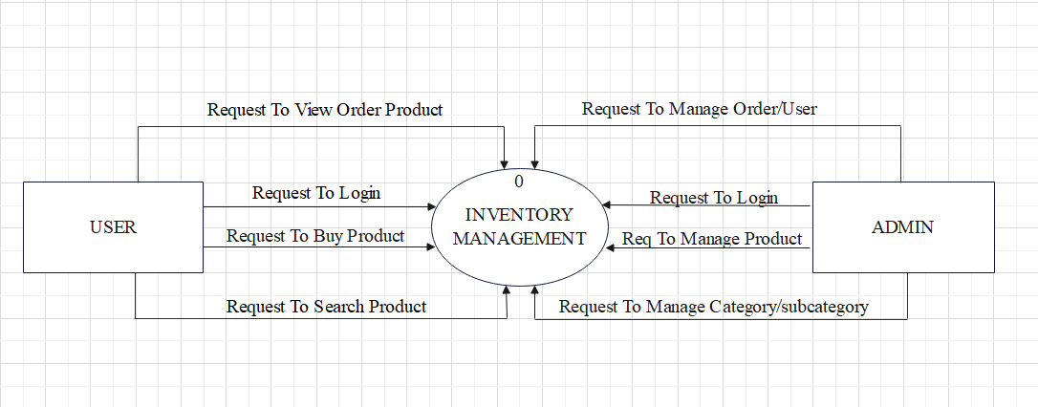
CONTEXT LEVEL

Slide 11
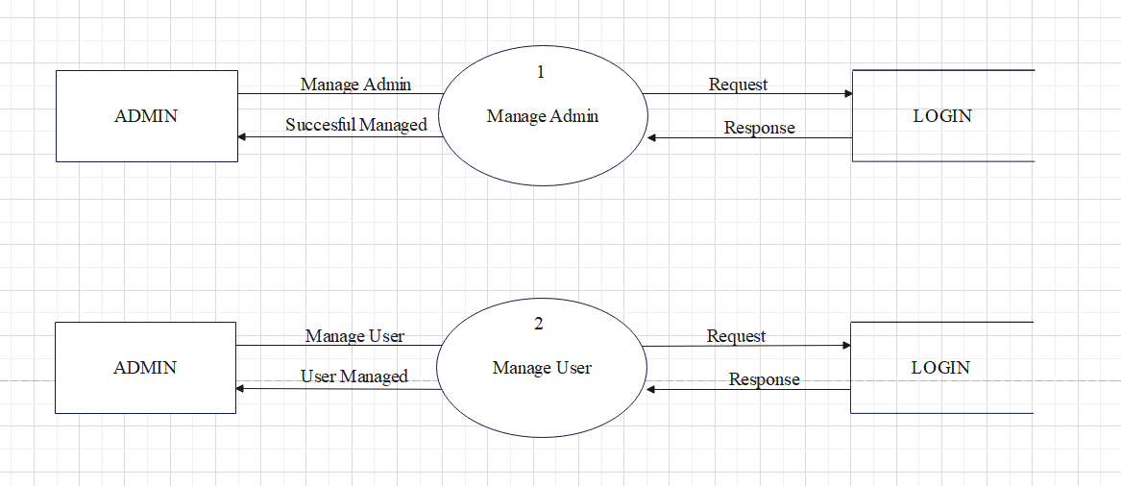
FIRST LEVEL

Slide 12
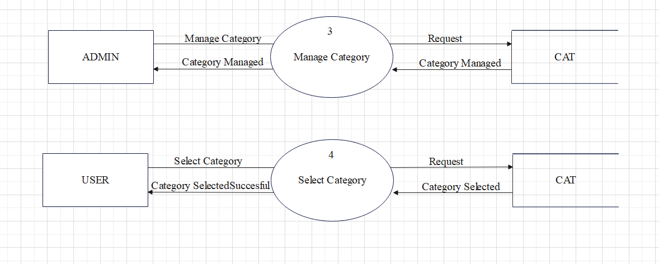
Continue

Slide 13
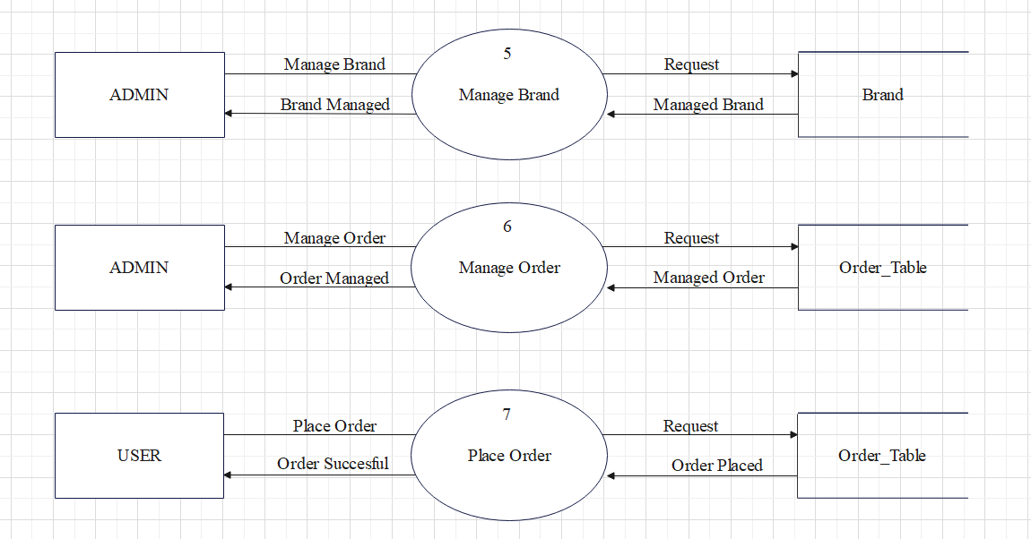
Continue

Slide 14
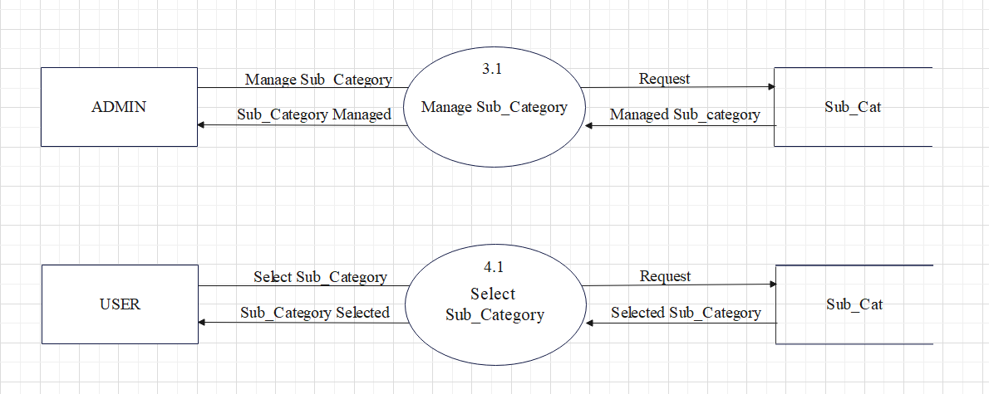
SECOND LEVEL

Slide 15
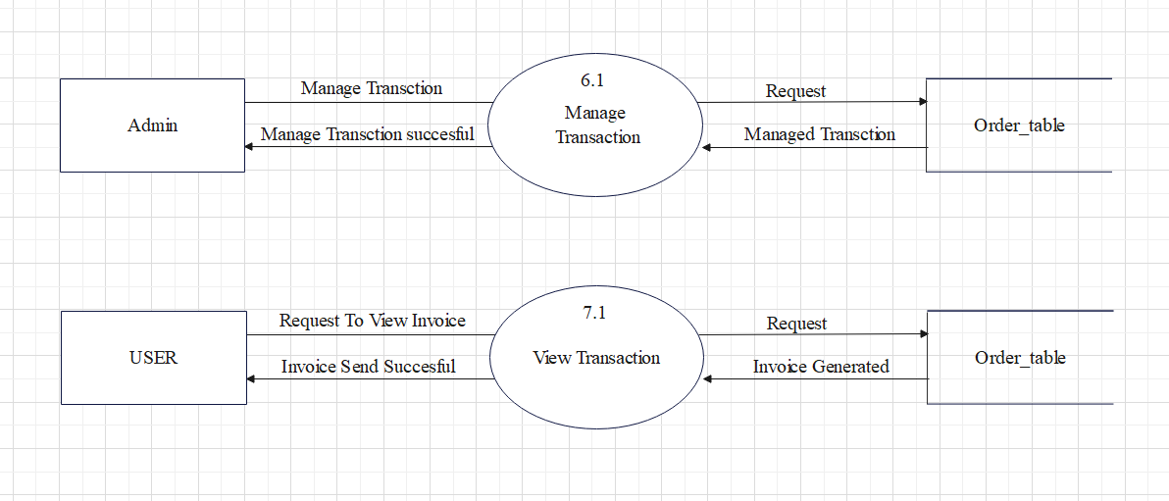
Continue

Slide 16
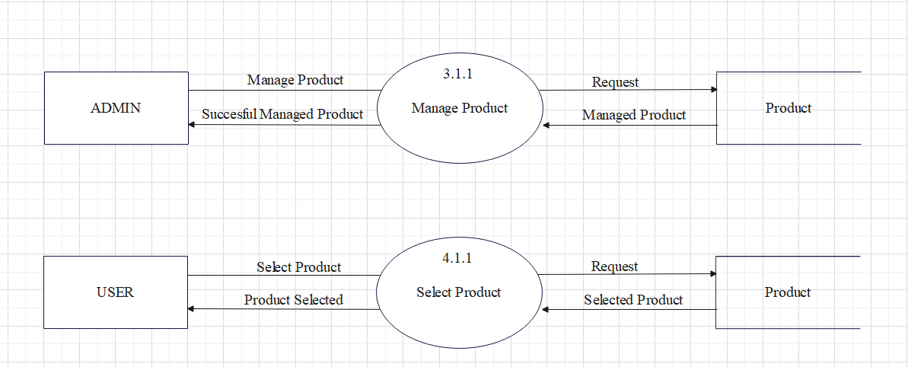
THIRD LEVEL

Slide 17
Data Dictionary

Slide 18
1. Login :-
Field Name | Type | Size | Constraint | Description
u_id | Int | 20 | Primary key | user/admin id
u_name | Varchar | 50 | Not null | user/admin name
u_mail | Varchar | 50 | Not null | user/admin mail
u_mobile | Varchar | 15 | Not null | user/admin mobile number
u_date | Date | - | Not null | Date
u_pass | Varchar | 20 | Not null | user/admin password
u_role | Varchar | 20 | Not null | role
u_img | Varchar | 50 | Not null | user/admin image path

Slide 19
2. Cat :-
Field Name | Type | Size | Constraint | Description
Id | Int | 20 | Primary key | category id
Category_name | Varchar | 50 | Not null | category name
Category_code | Varchar | 50 | Unique key | category code
image | Varchar | 50 | Not null | category image

Slide 20
3. sub_cat :-
Field Name | Type | Size | Constraint | Description
Sub_id | Int | 20 | Primary key | subcategory id
Sub_name | Varchar | 50 | Not null | sub-category name
Sub_desc | Varchar | 50 | Not null | sub-category description
Cat_id | Varchar | 20 | Foreign key | category id
Sccode | Varchar | 20 | Unique key | sub-category code

Slide 21
4. Brand :-
Field Name | Type | Size | Constraint | Description
b_id | Int | 10 | Primary key | brand id
b_name | Varchar | 50 | Unique key | brand name
b_img | Varchar | 50 | Not null | brand image

Slide 22
5. Product :-
Field Name | Type | Size | Constraint | Description
P_id | Int | 20 | Primary key | product id
P_name | Varchar | 50 | Not null | product name
p_code | Varchar | 50 | unique key | product code
cat_id | Int | 20 | Foreign key | category id
subcat_id | Int | 20 | Foreign key | sub-category id
b_id | Int | 20 | Foreign key | brand id
unit | Varchar | 50 | Not null | product units
Minimum_qty | Int | 20 | Not null | minimun quantity of product

Slide 23
Continue
Field Name | Type | Size | Constraint | Description
p_desc | Varchar | 100 | Not null | product description
quantity | Int | 20 | Not null | product quantity
discount | Int | 20 | Not null | product discount
R_price | Int | 20 | Not null | real price of product
P_price | Int | 20 | Not null | selling price of product
P_status | Varchar | 30 | Not null | status of product
P_image | Varchar | 50 | Not null | image of product

Slide 24
6. Add_To_Cart :-
Field Name | Type | Size | Constraint | Description
Product_id | Int | 20 | Foreign key | Product Id
User_id | Int | 20 | Foreign key | User Id
A_quantity | Int | 20 | Not null | the quantity of product
A_price | Int | 20 | Not null | price of the product
A_img | Varchar | 50 | Not null | image of product

Slide 25
7. Order_table:-
Field Name | Type | Size | Constraint | Description
Order_id | Varchar | 50 | Not null | reference order number
p_id | Varchar | 20 | Foreign key | product id
user_id | Int | 20 | Foreign key | user id
order_status | Varchar | 20 | Not null | order status
order_date | Date | - | Not null | order date
order_total | Int | 50 | Not null | selling price product total
order_quantity | Int | 20 | Not null | the product quantity

Slide 26
ER DIAGRAM

Slide 27
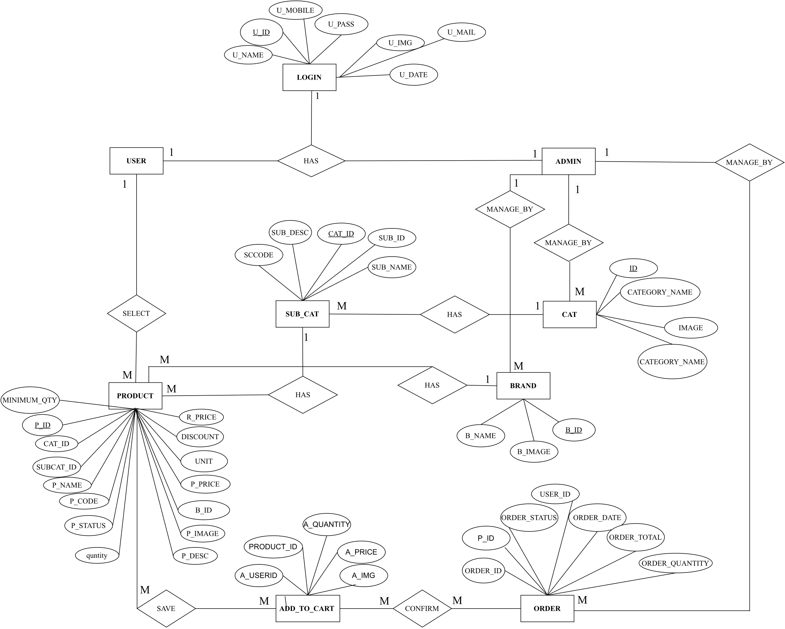

Slide 28
SCREENSHORT

Slide 29
Admin Module

Slide 30
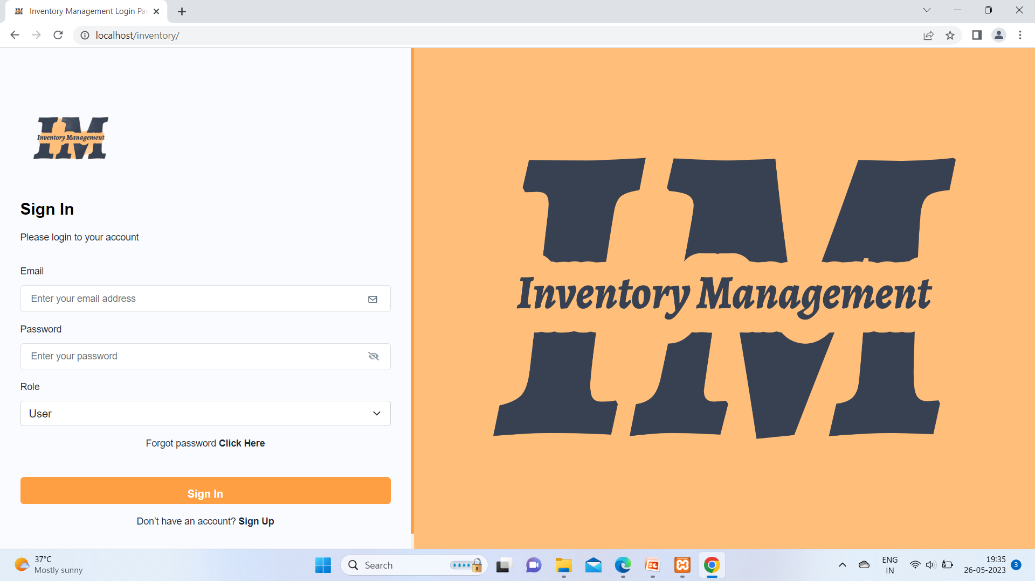

Slide 31
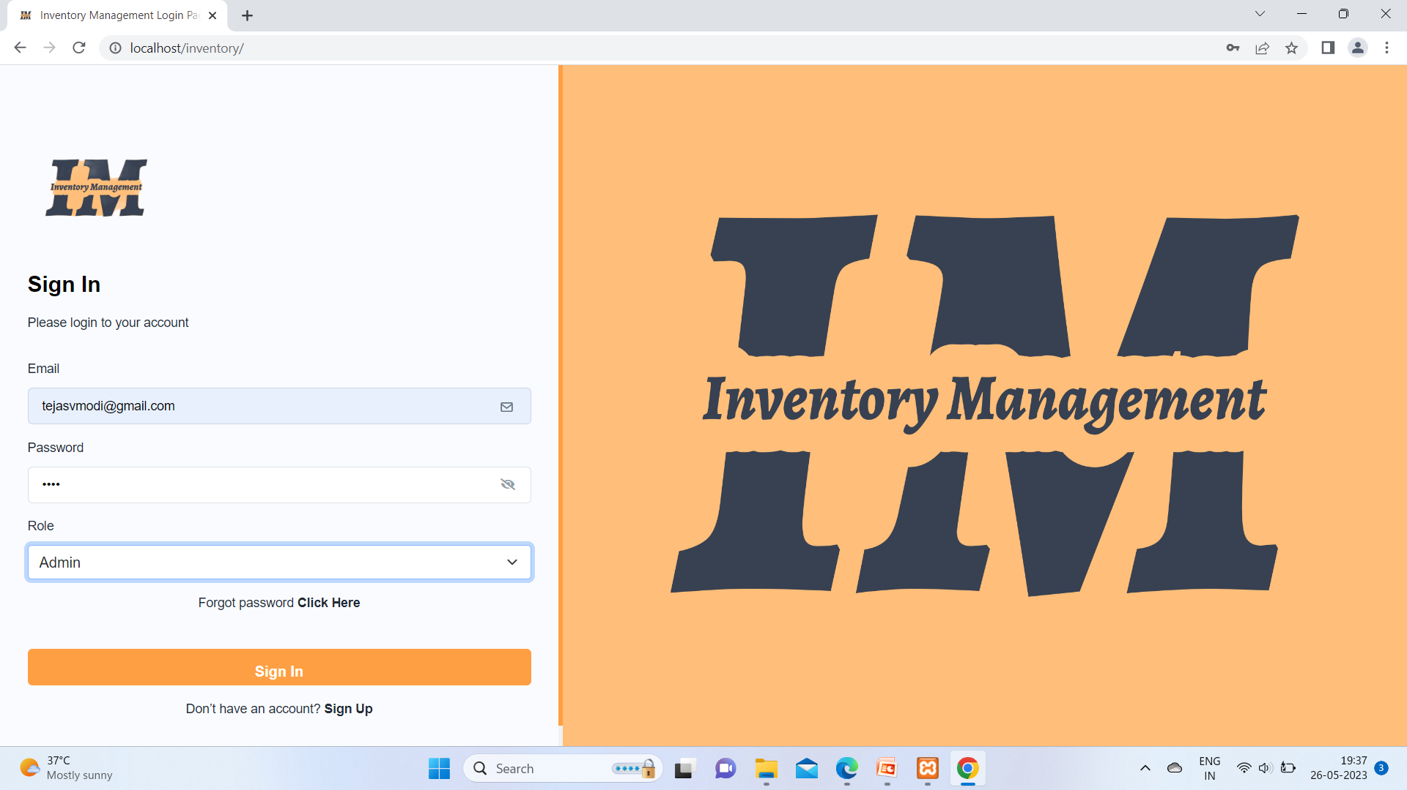

Slide 32
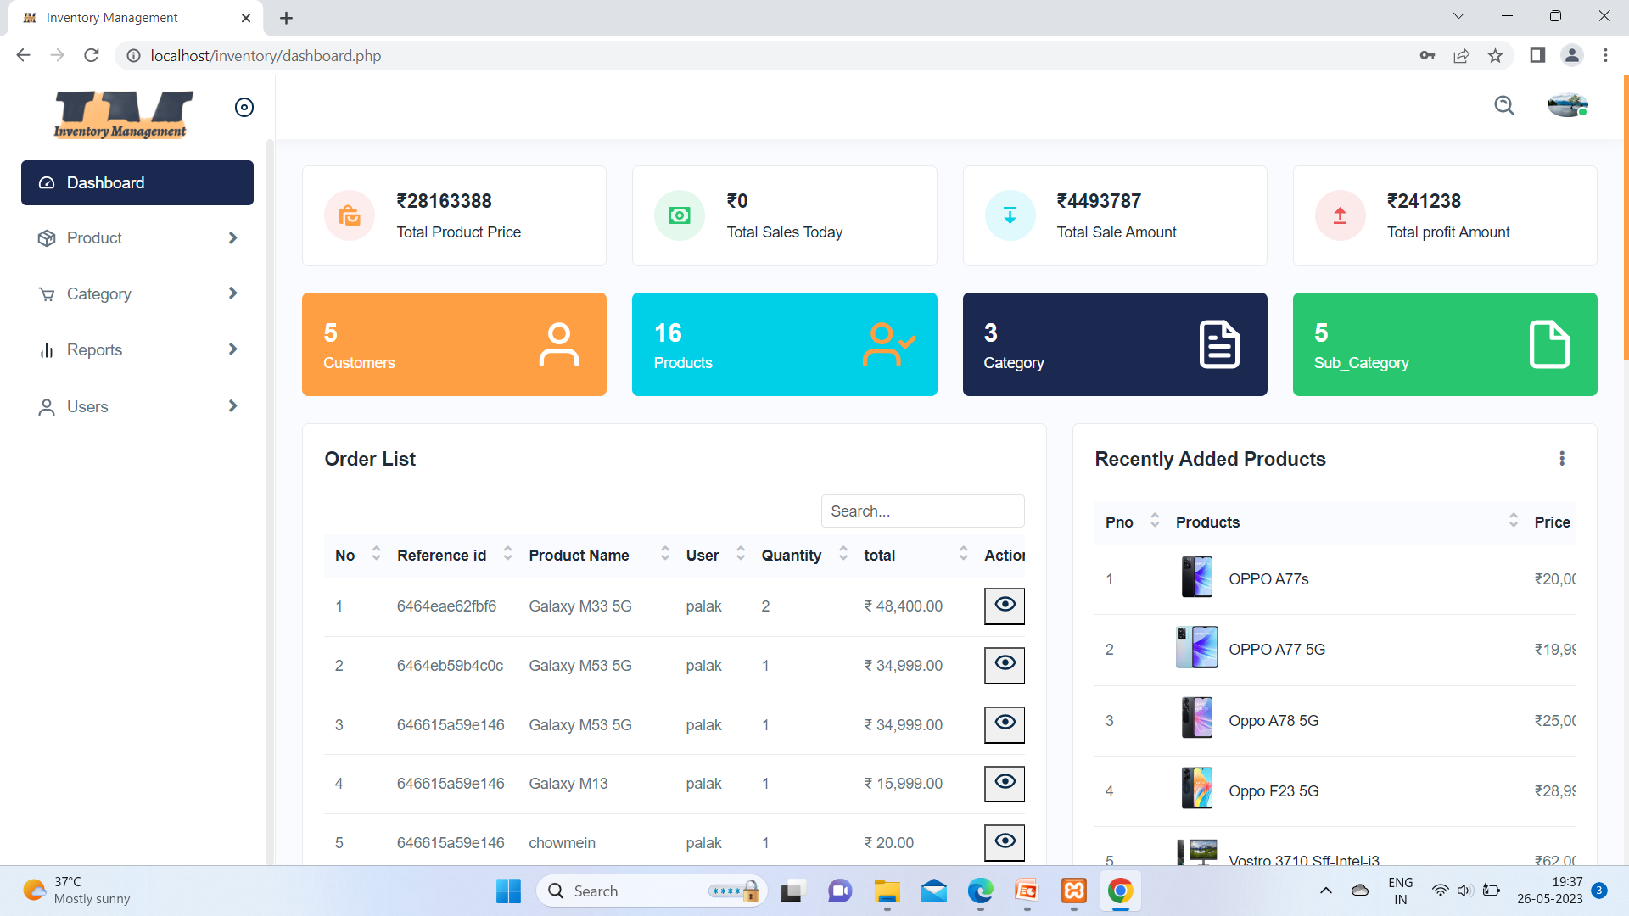

Slide 33
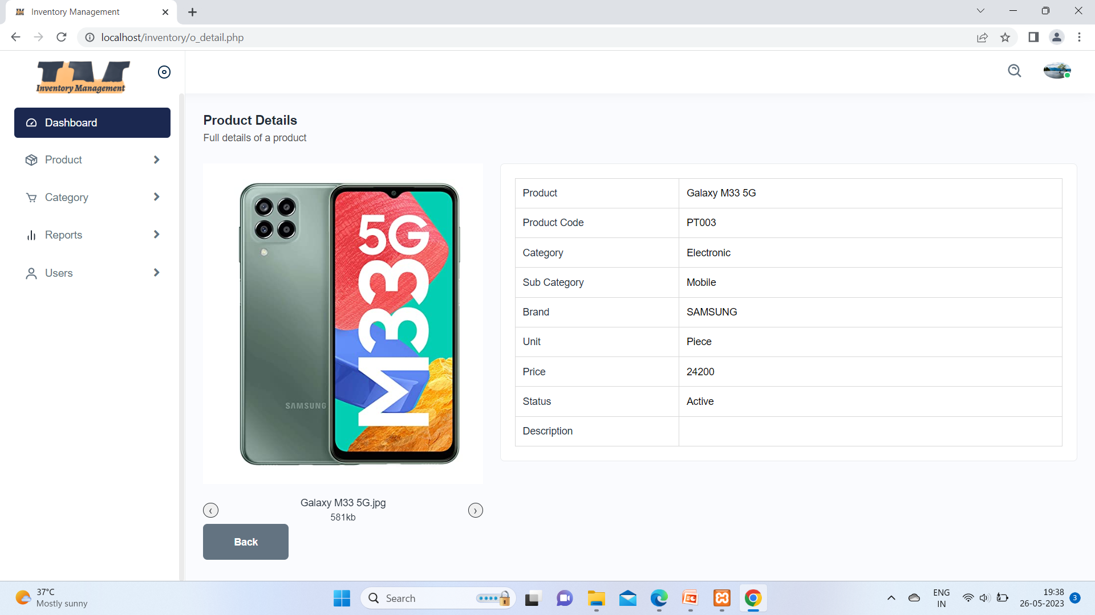

Slide 34


Slide 35
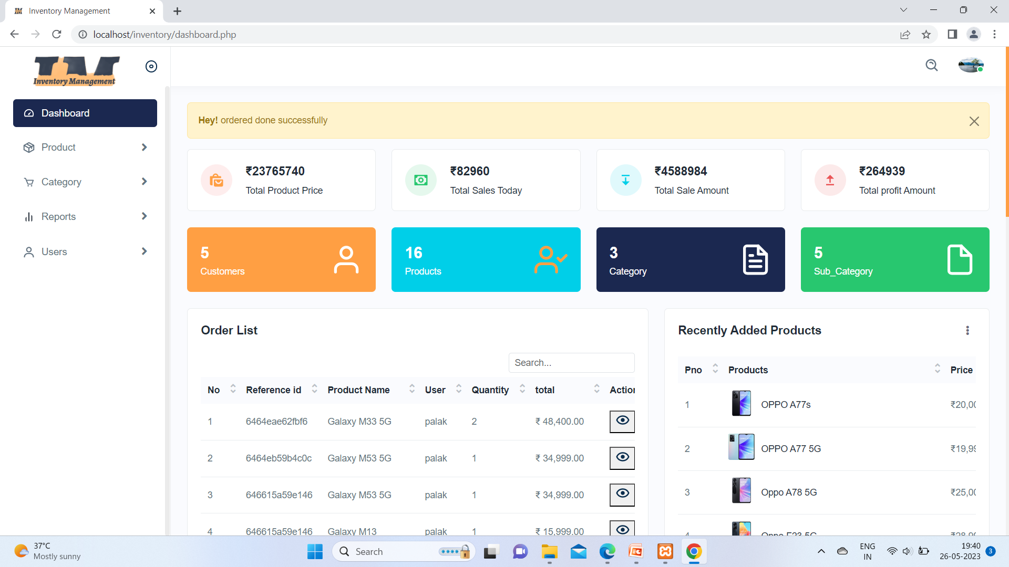

Slide 36
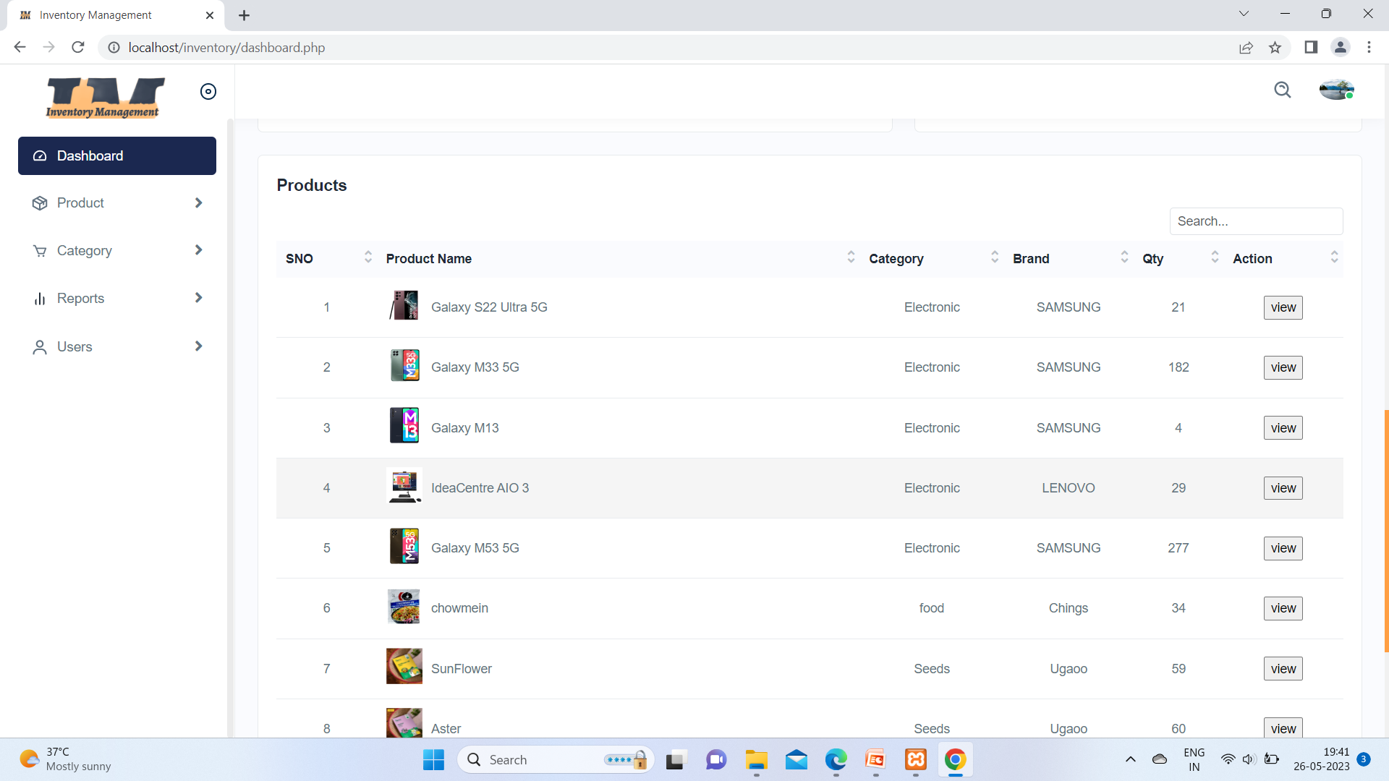

Slide 37
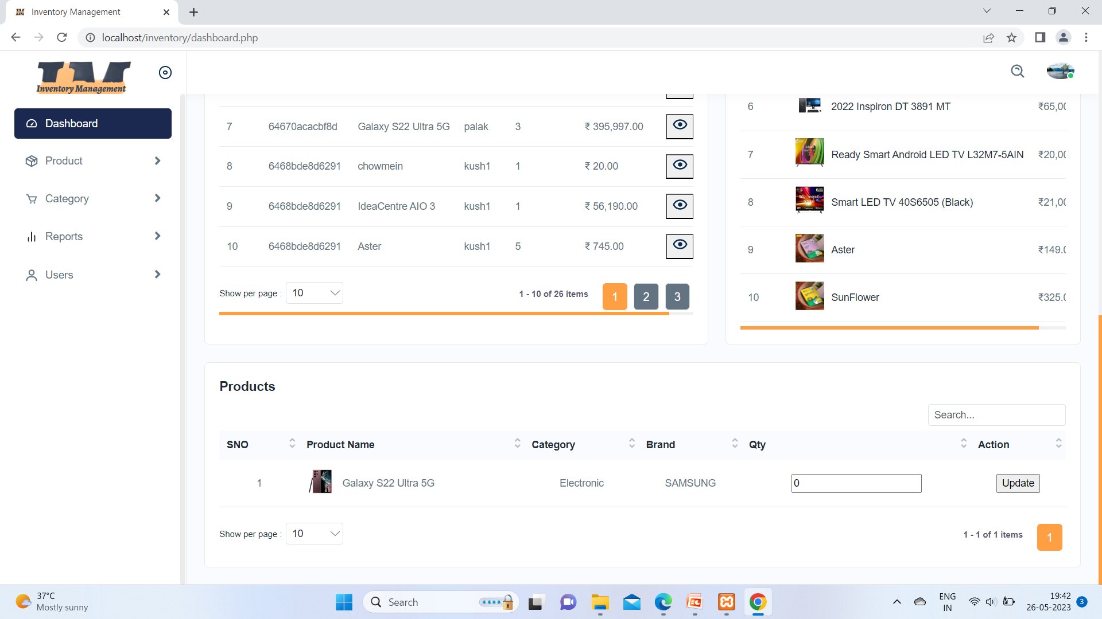

Slide 38
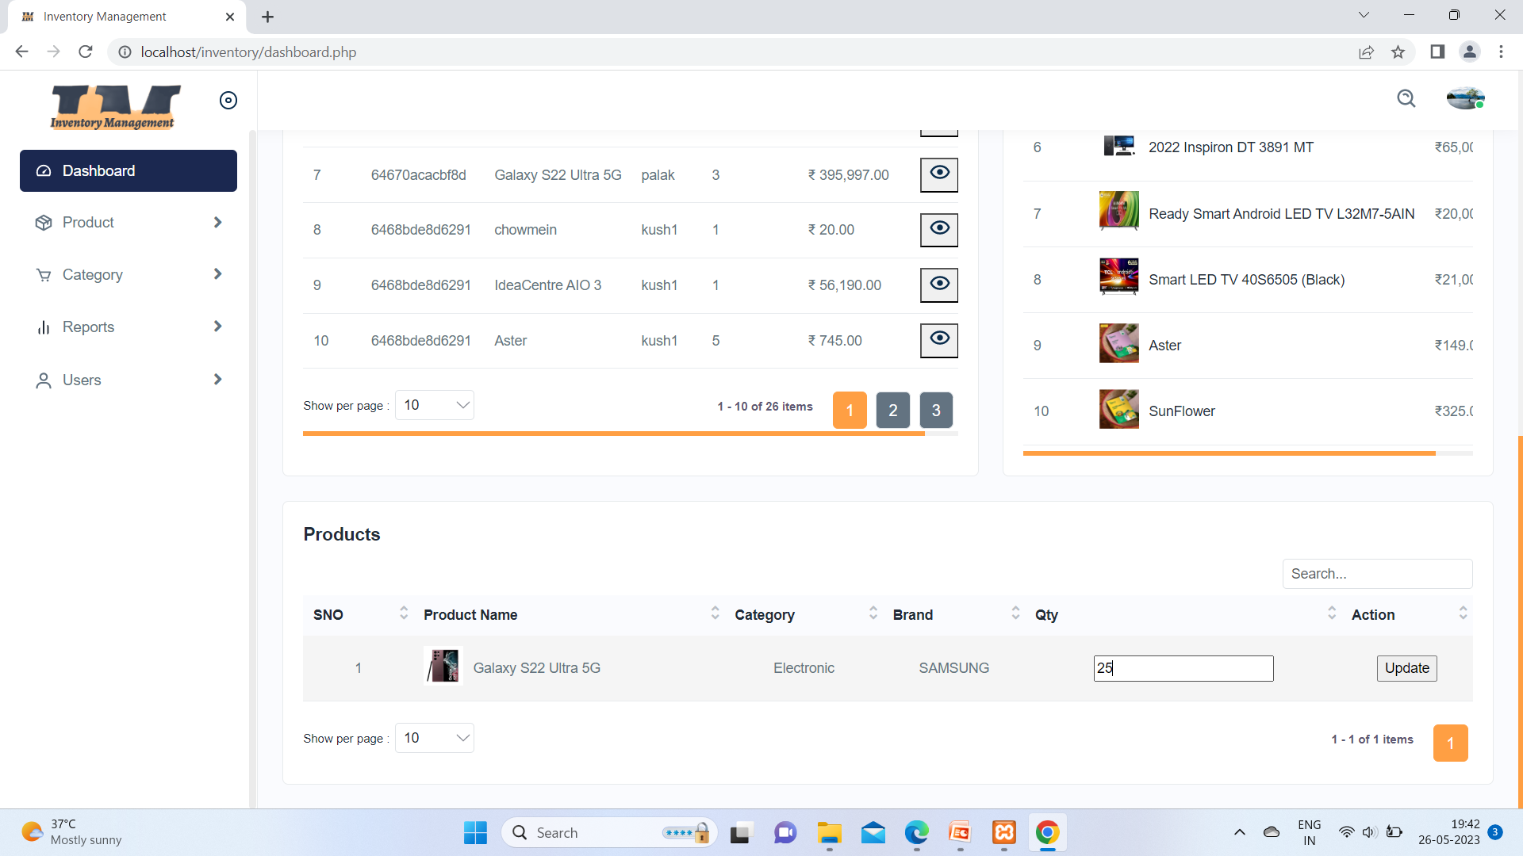

Slide 39


Slide 40
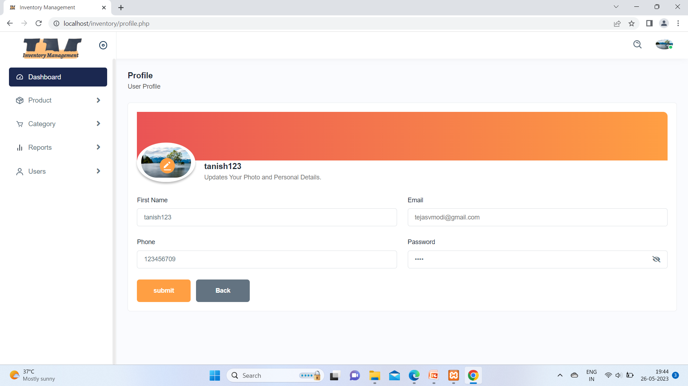

Slide 41
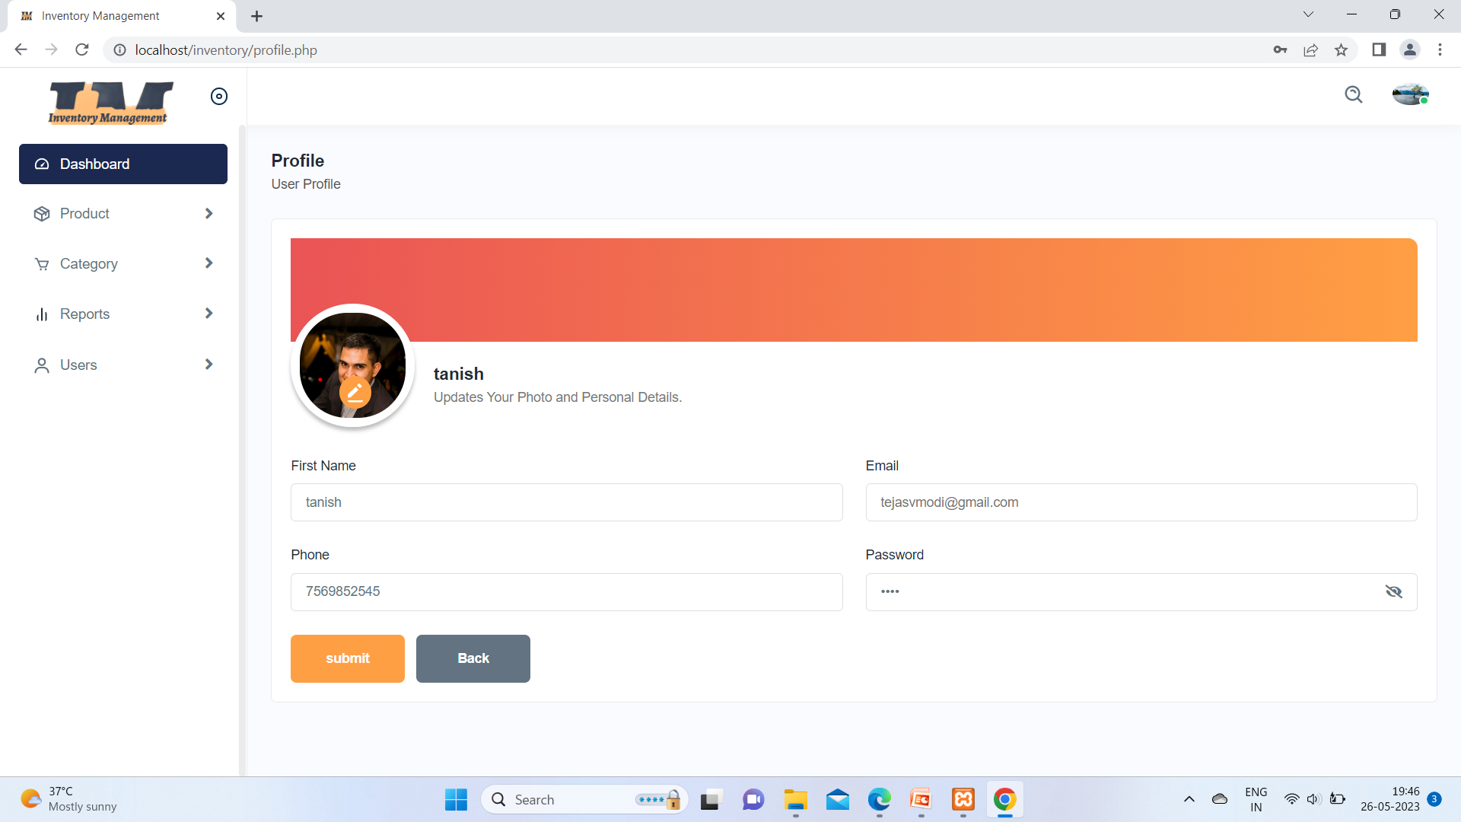

Slide 42
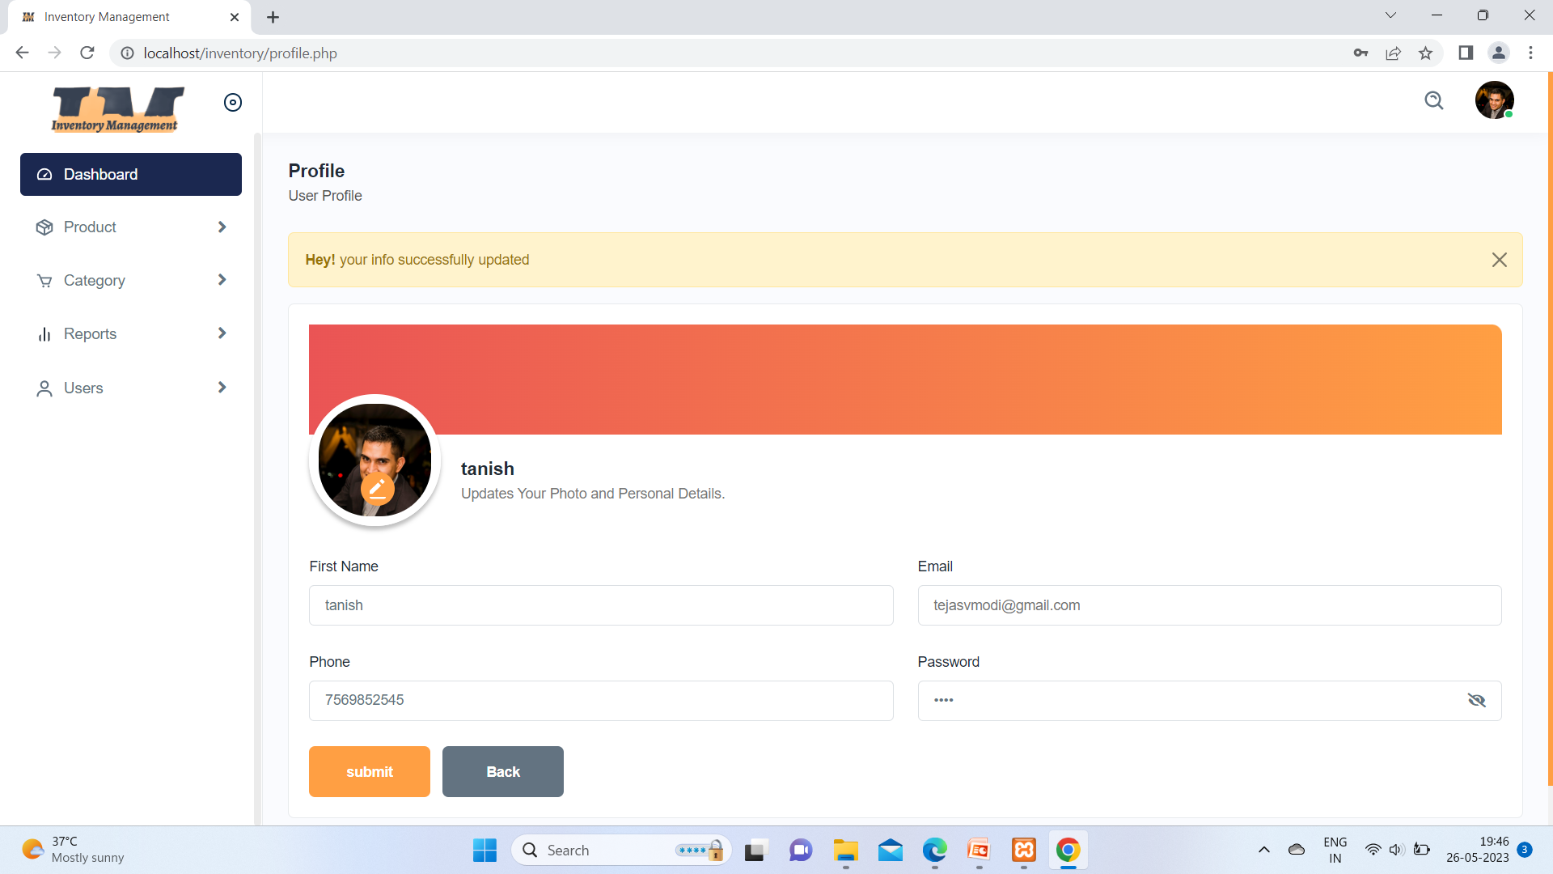

Slide 43
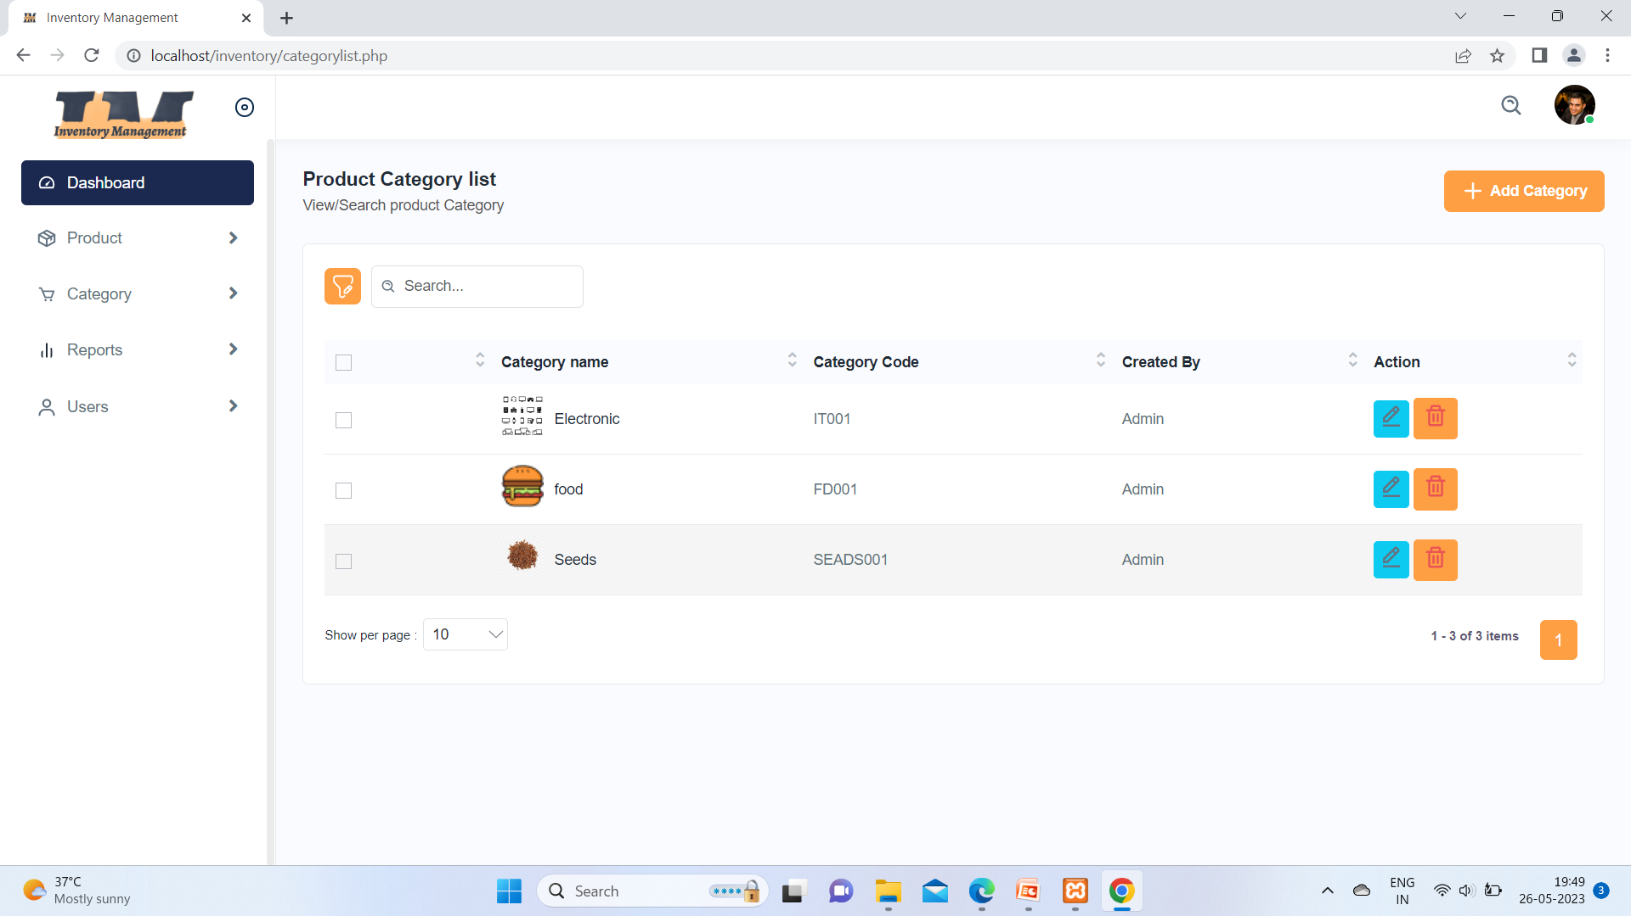

Slide 44
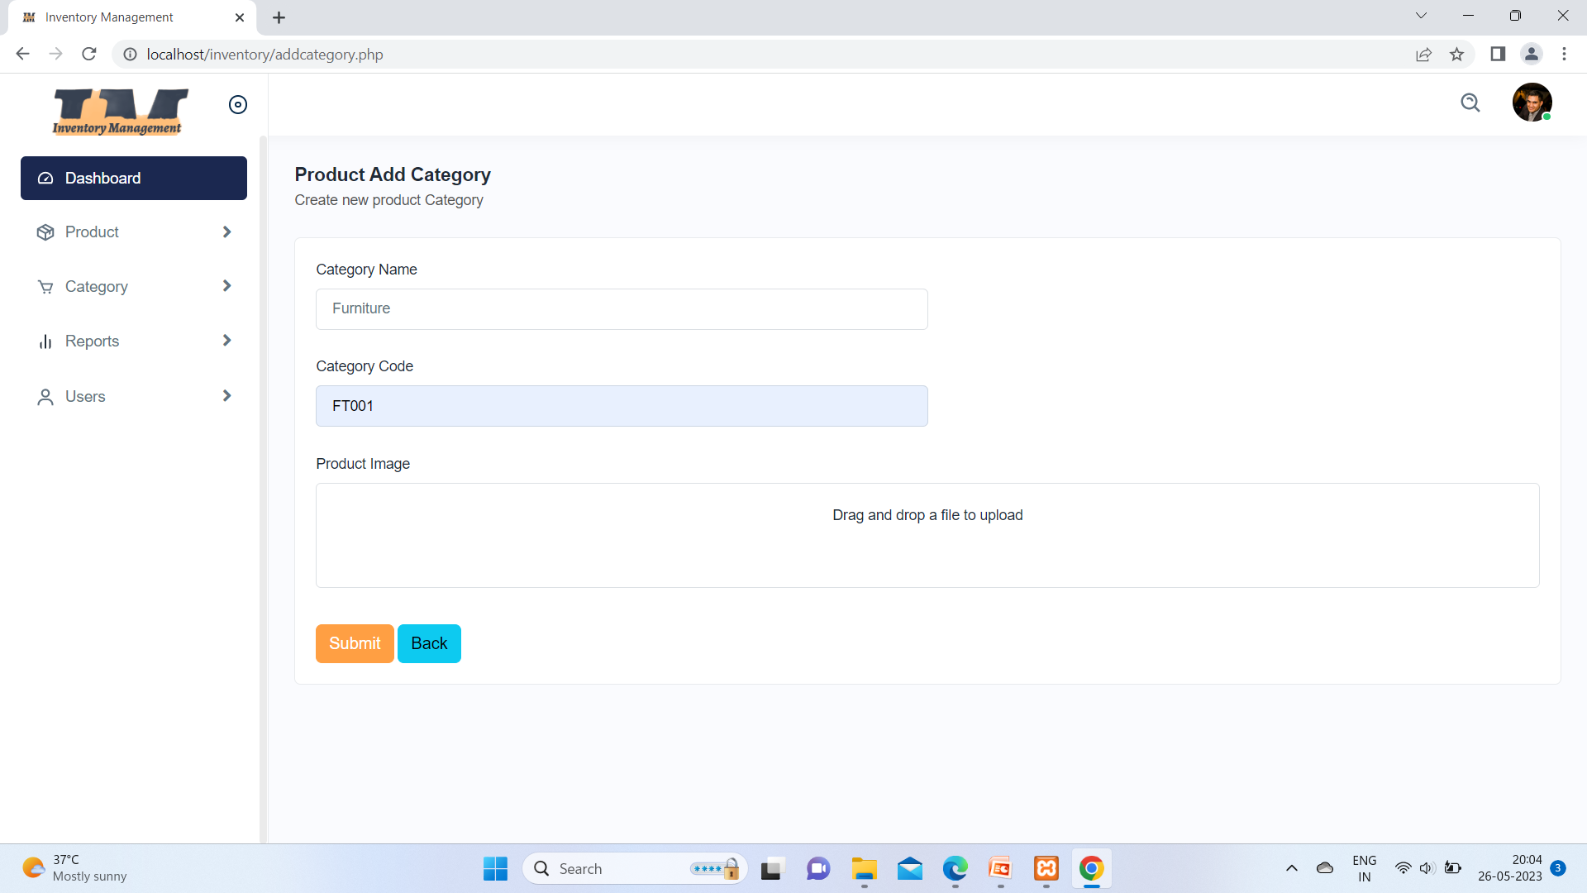

Slide 45
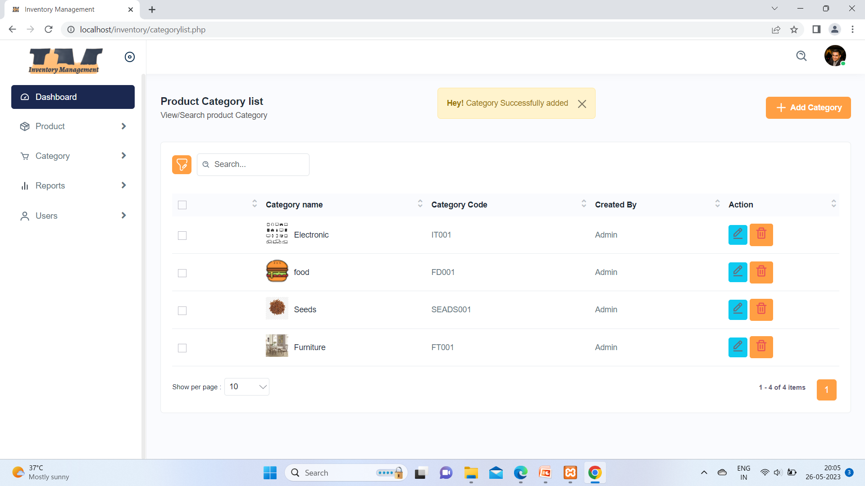

Slide 46
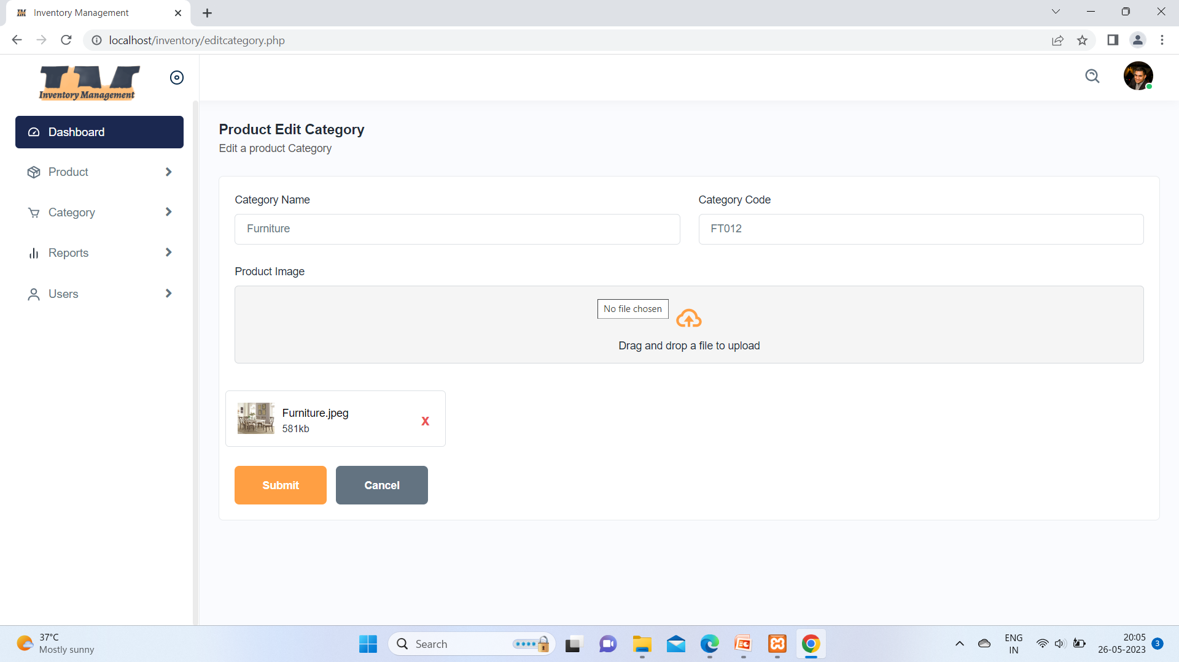

Slide 47


Slide 48
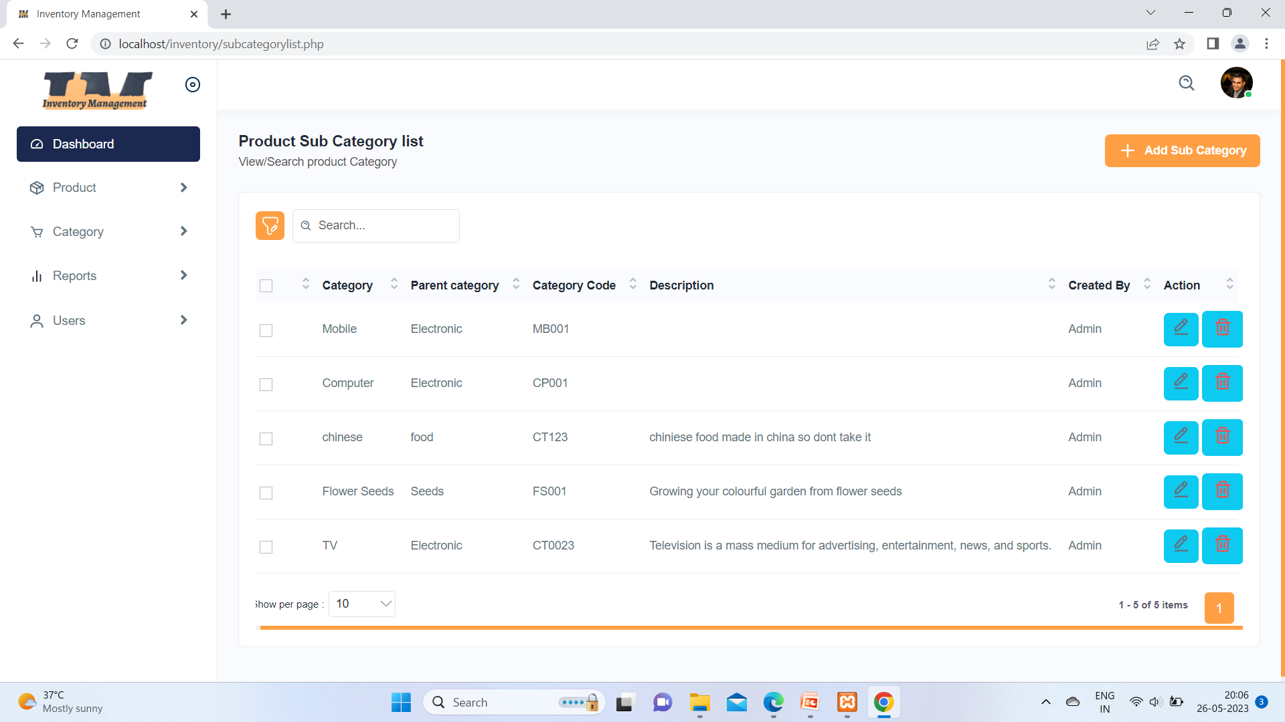

Slide 49
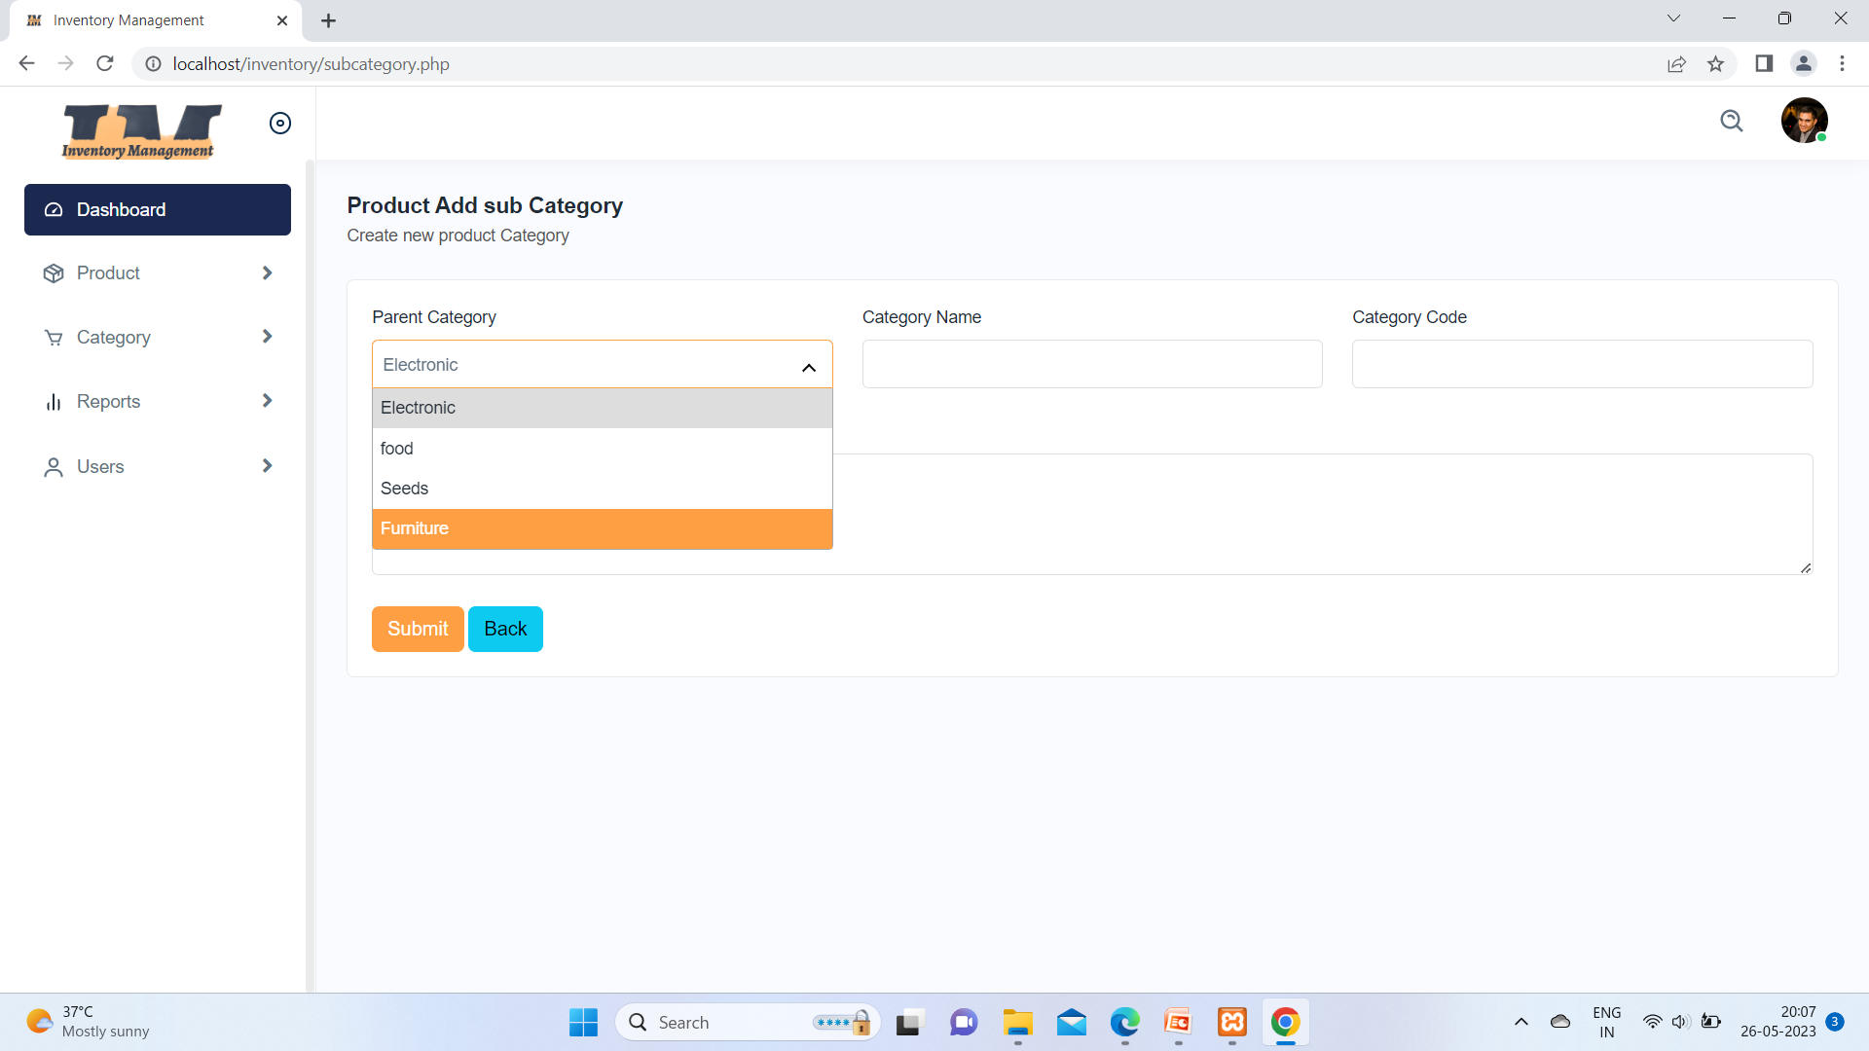

Slide 50
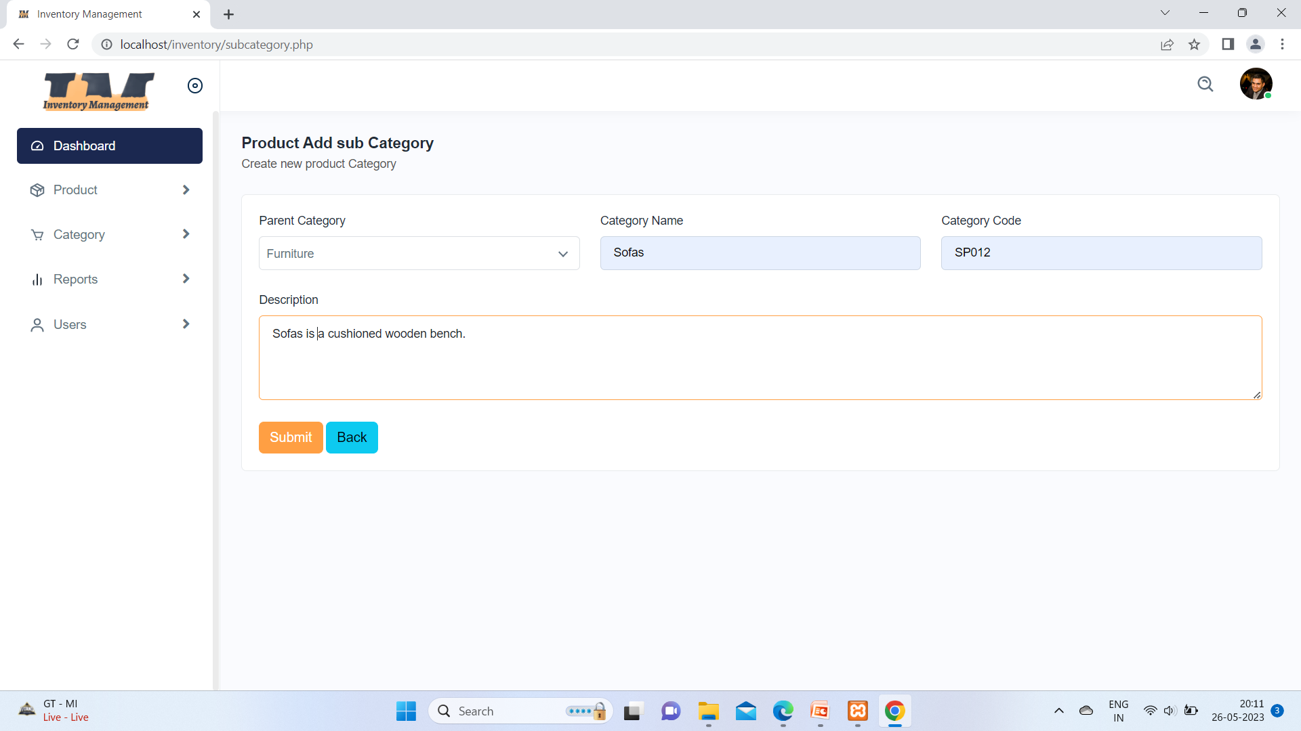

Slide 51
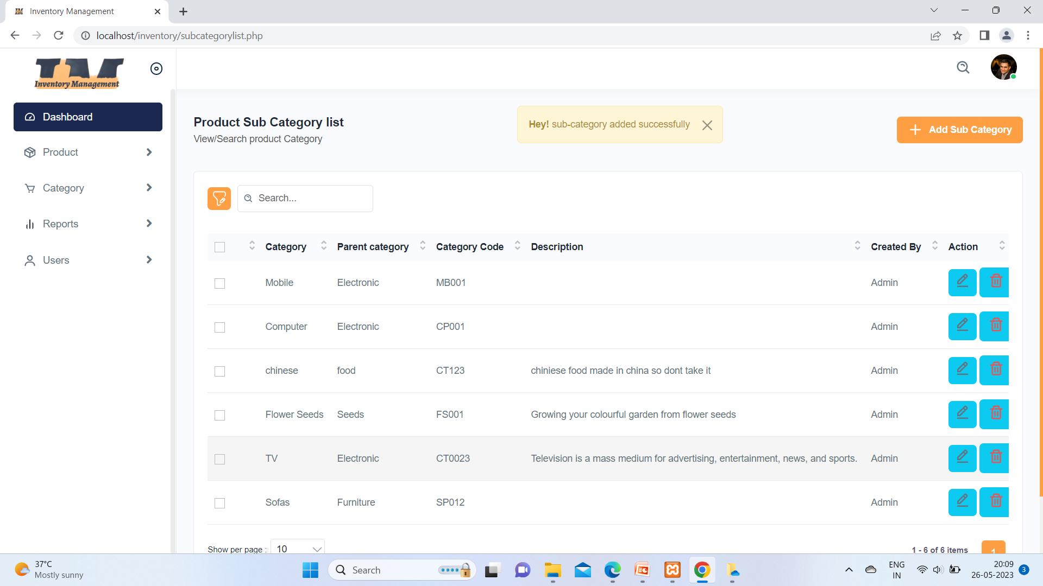
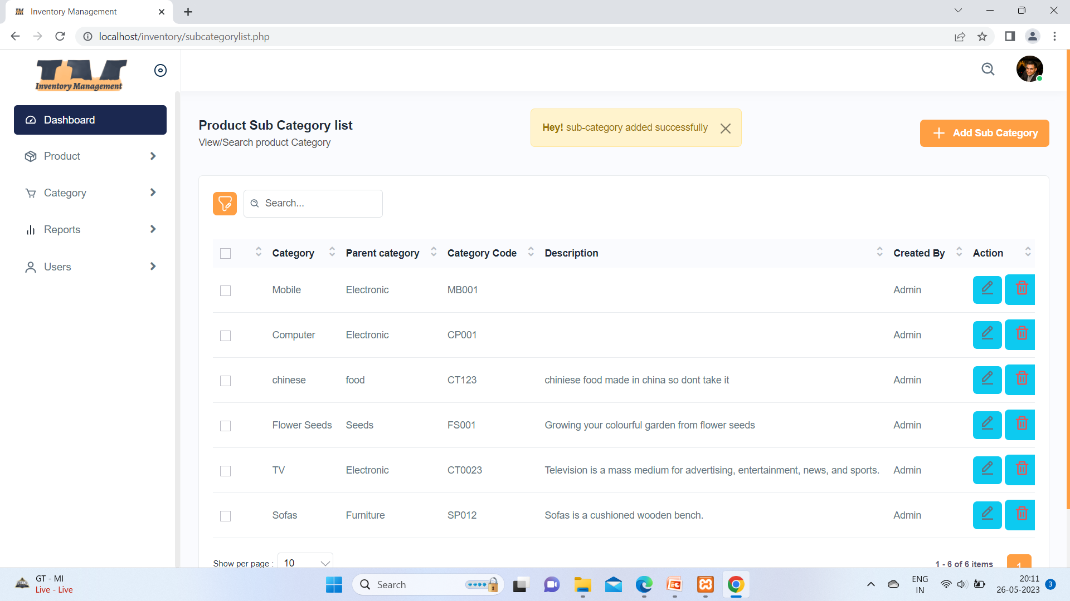

Slide 52
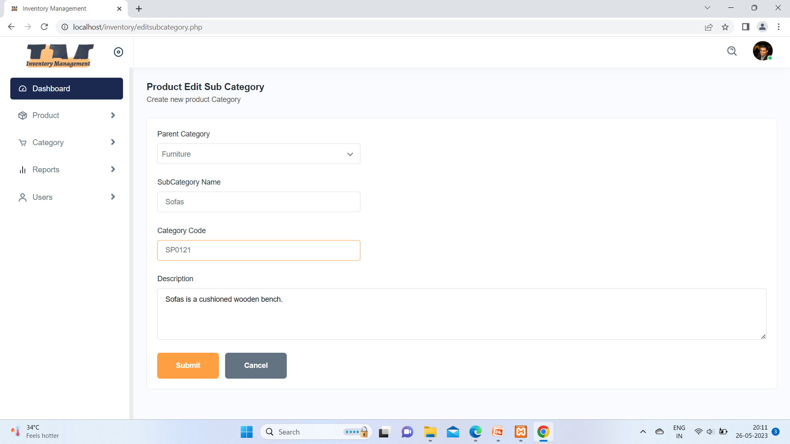

Slide 53


Slide 54
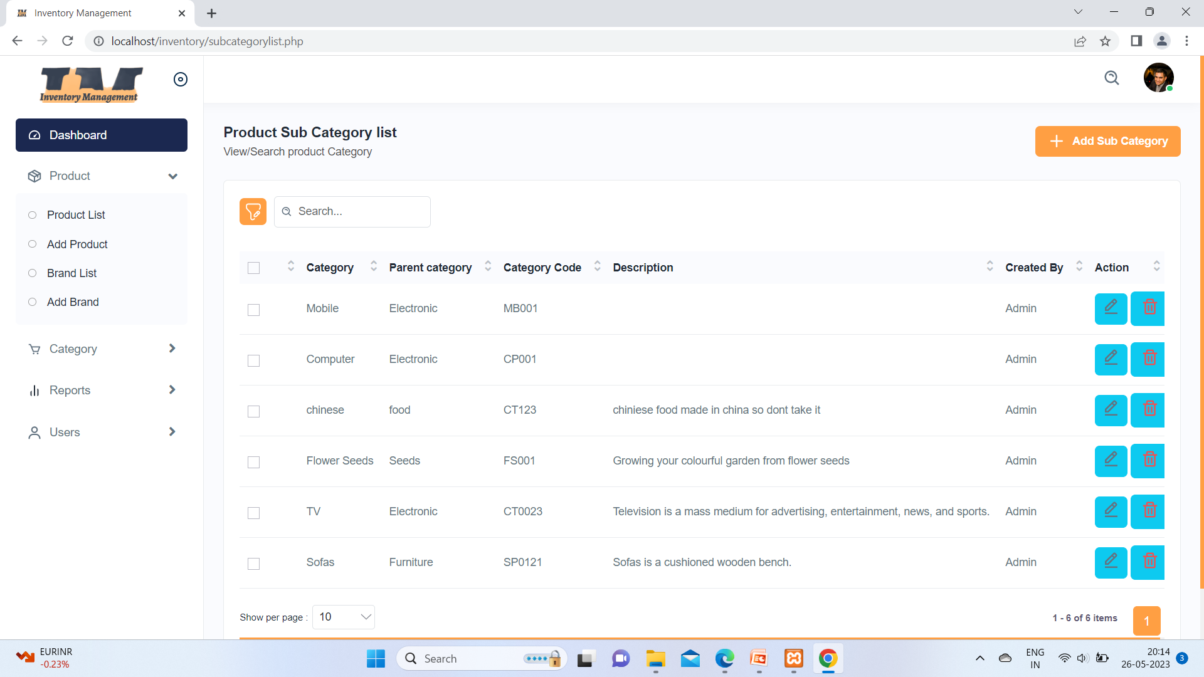

Slide 55
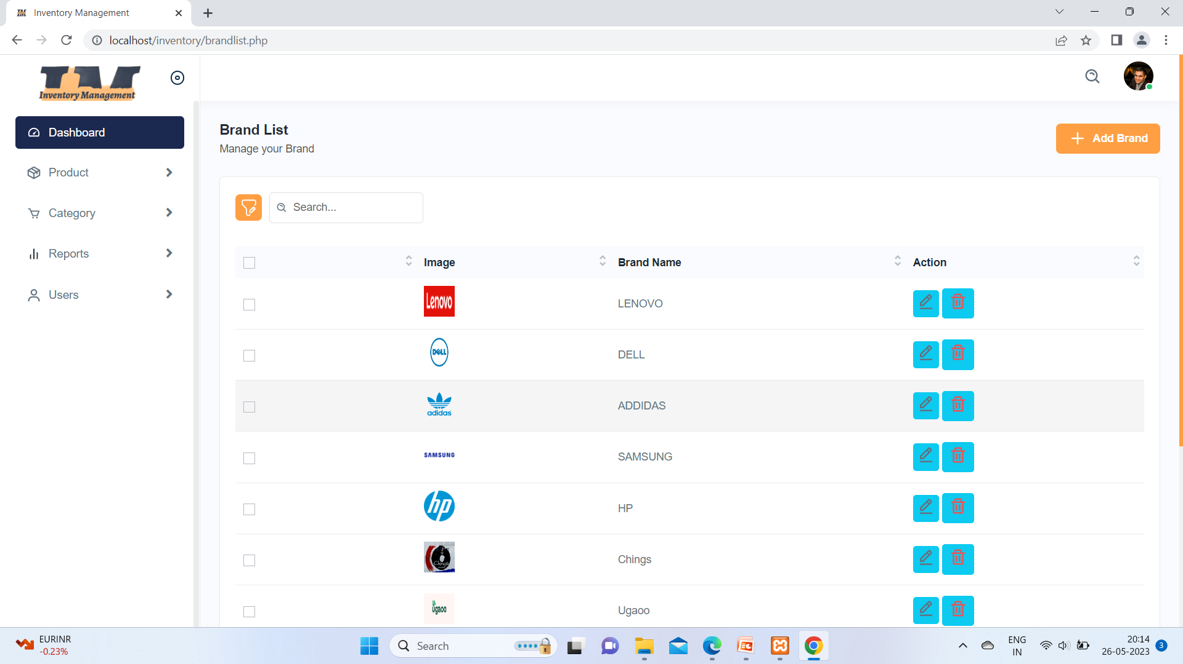

Slide 56
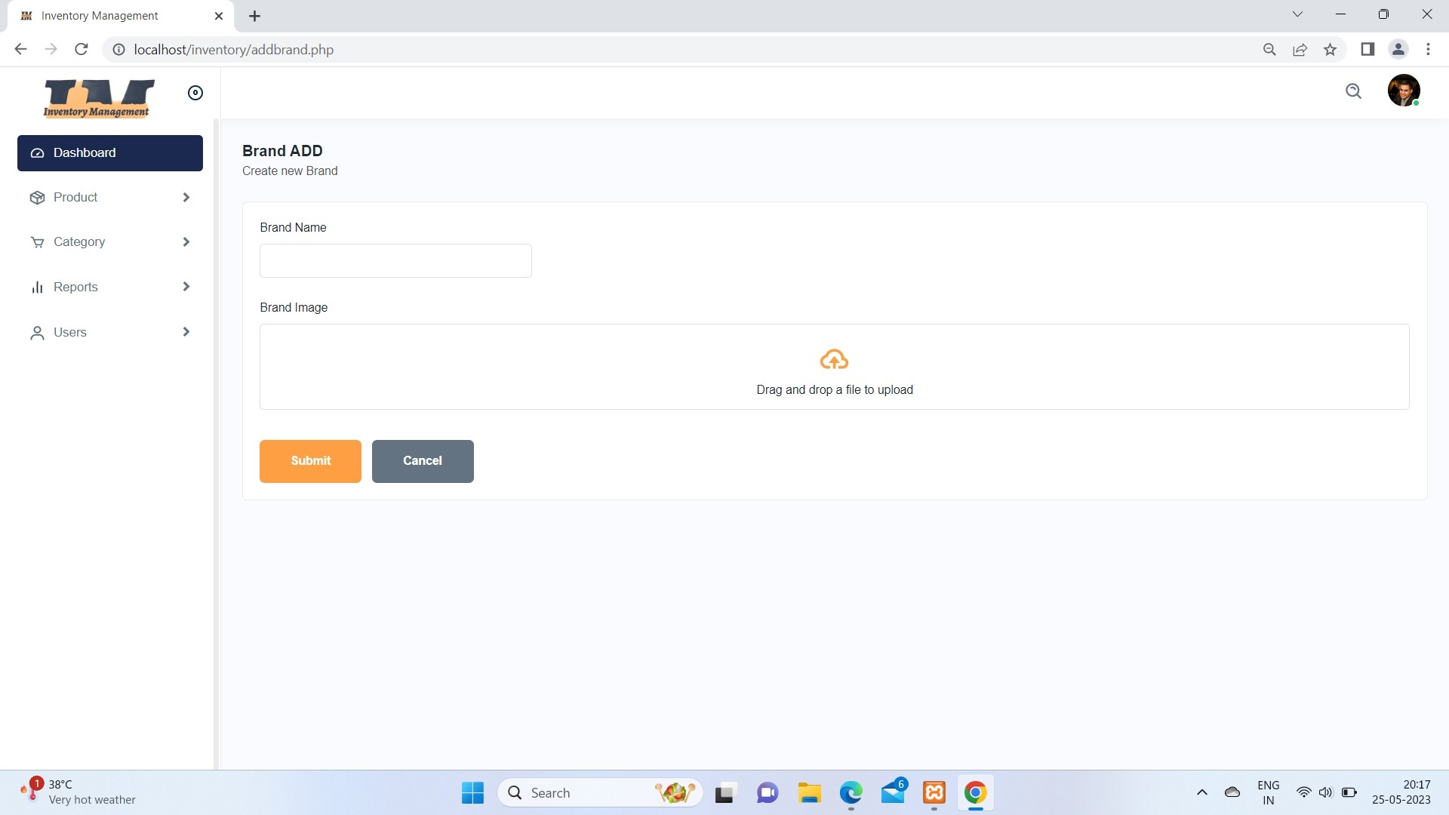

Slide 57
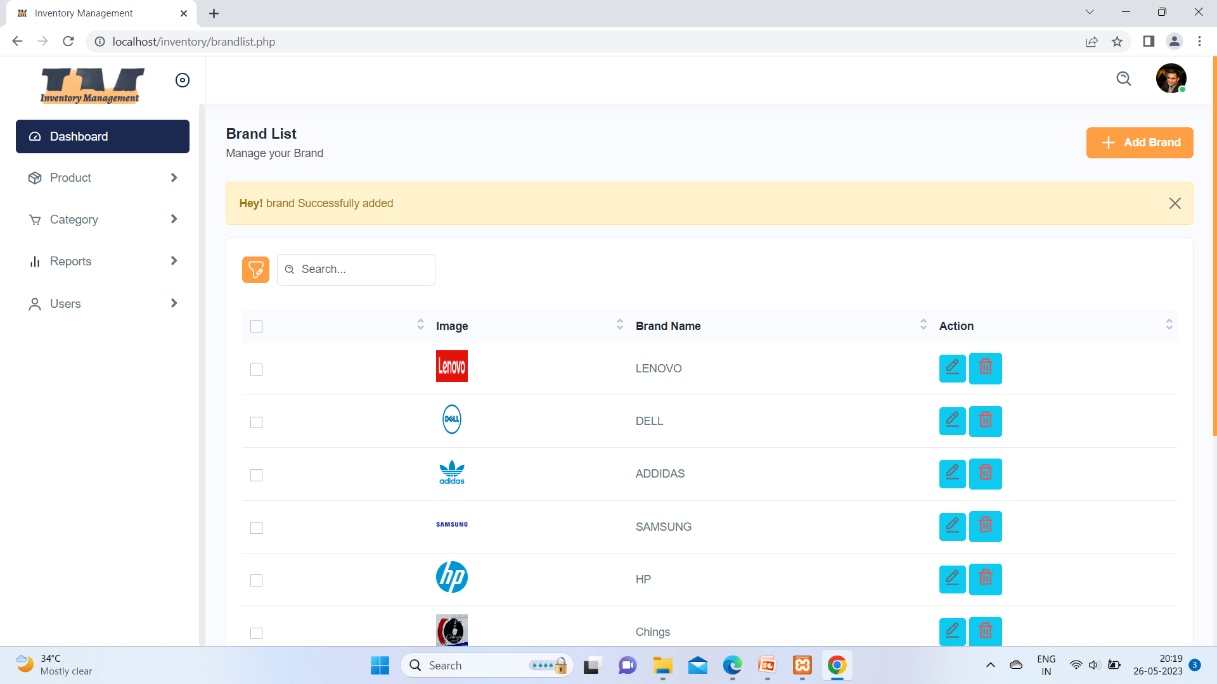

Slide 58
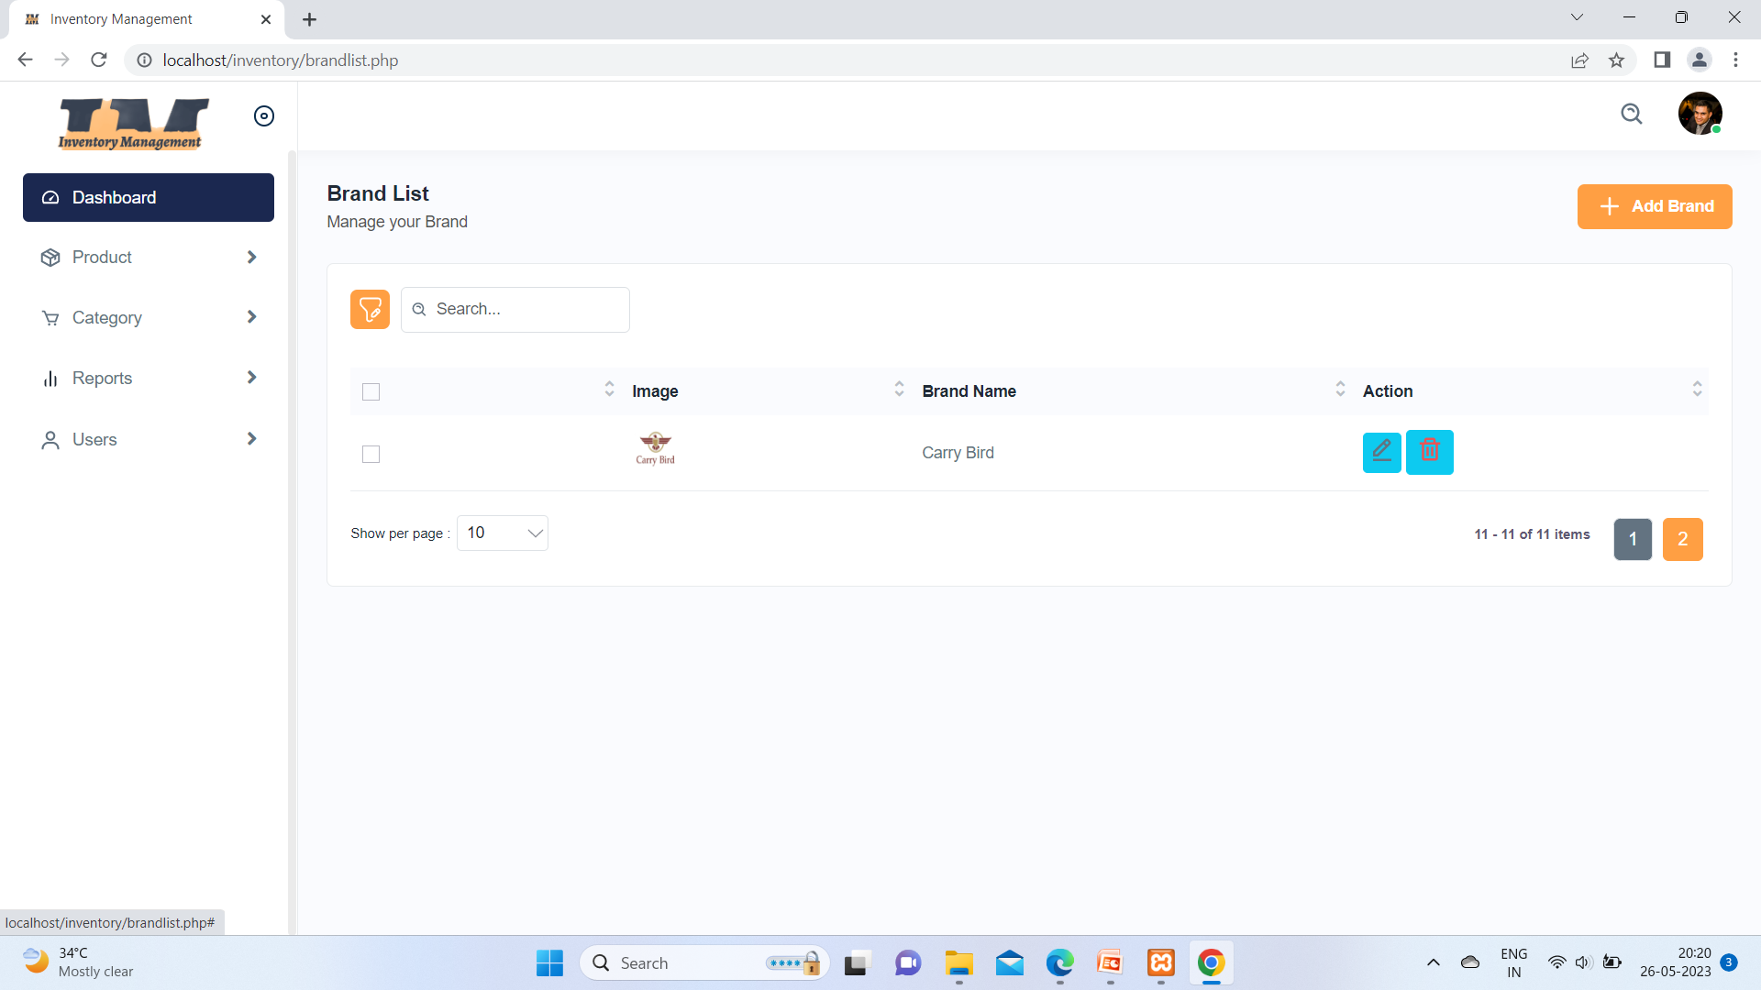

Slide 59
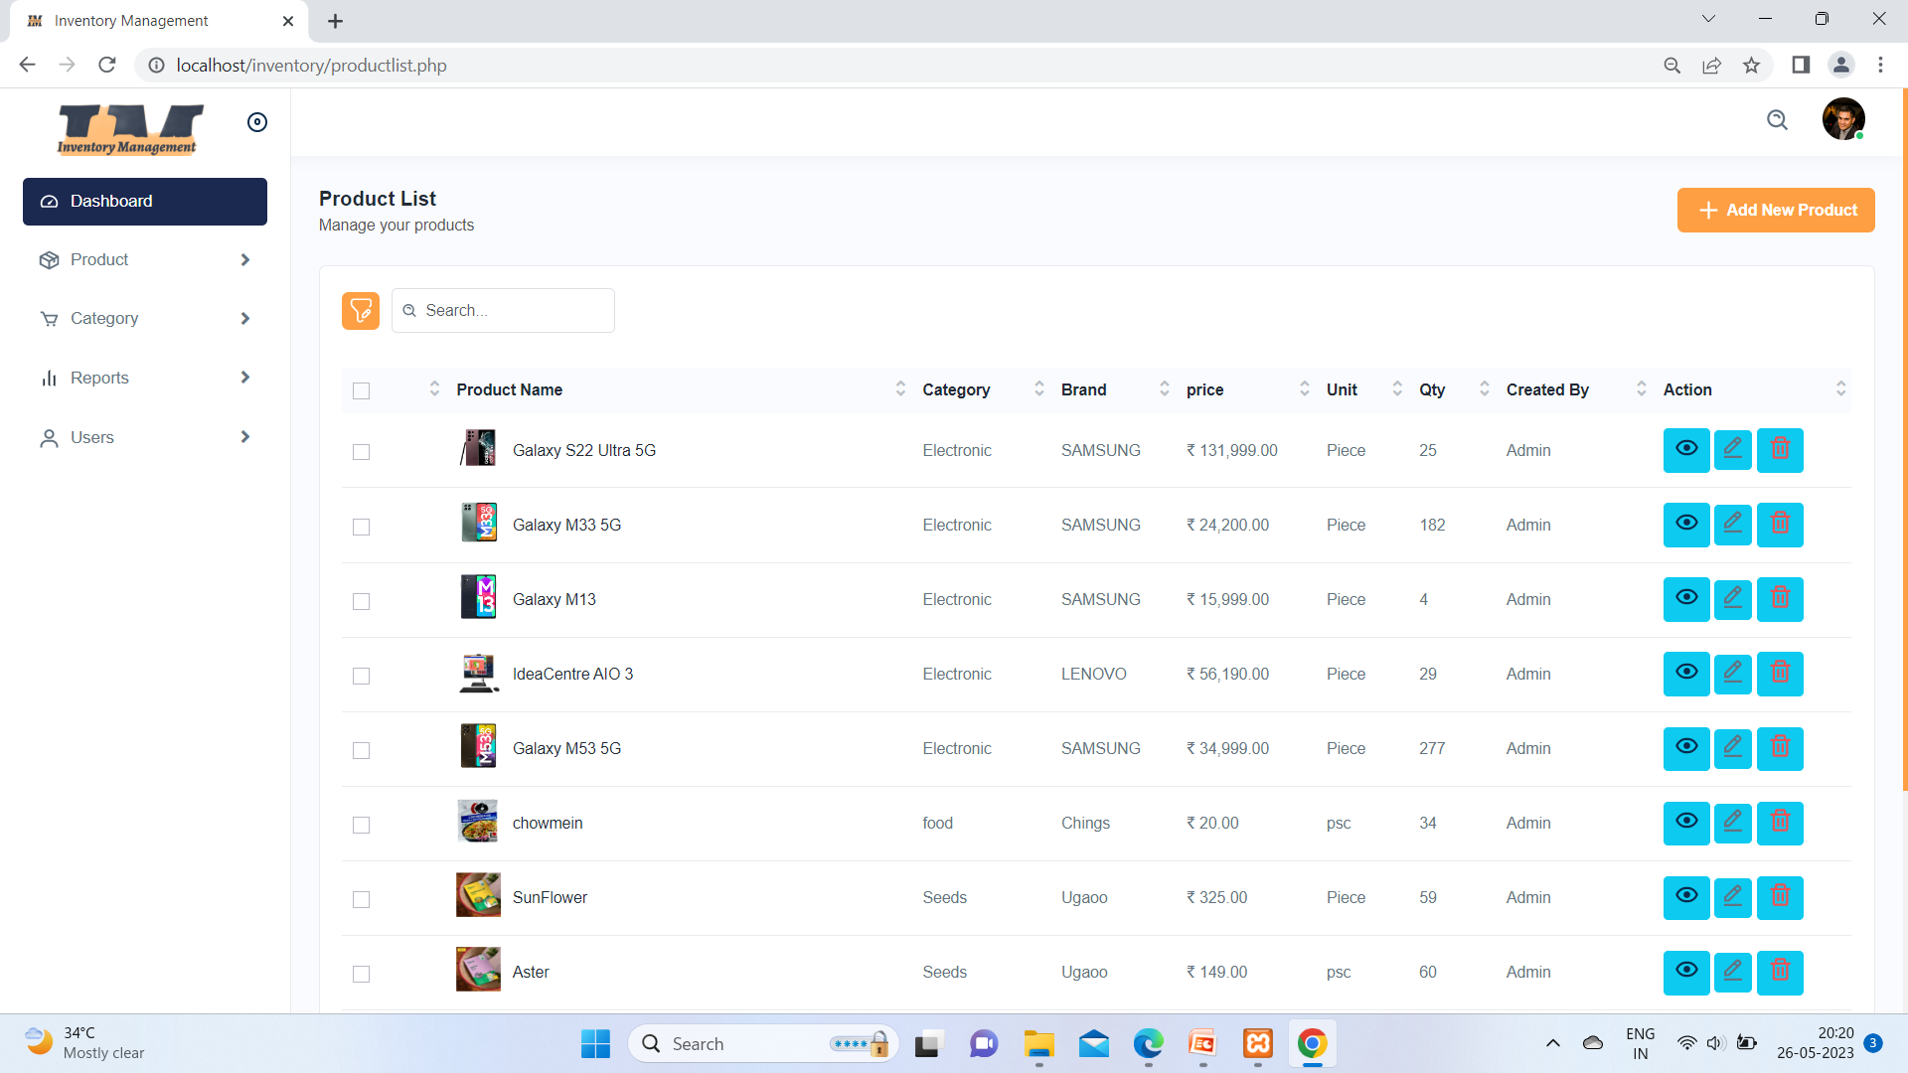

Slide 60
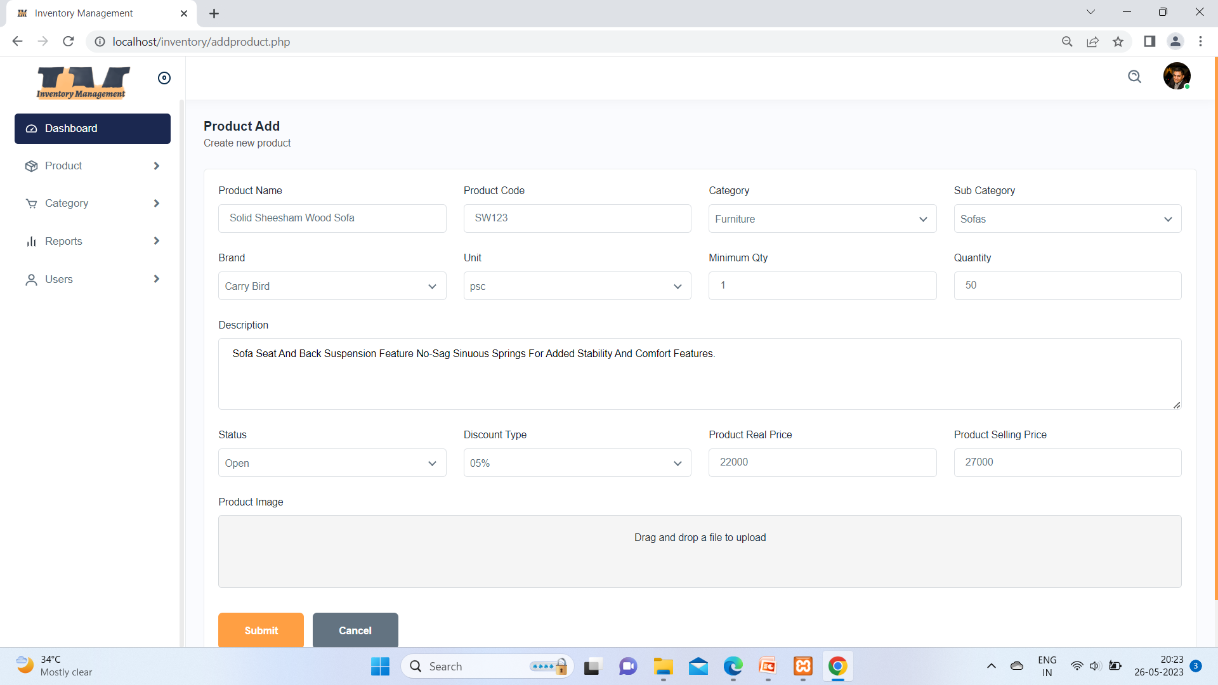

Slide 61
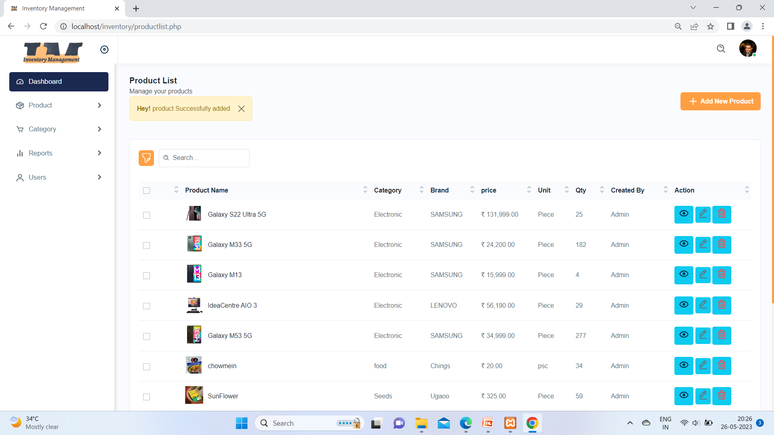

Slide 62
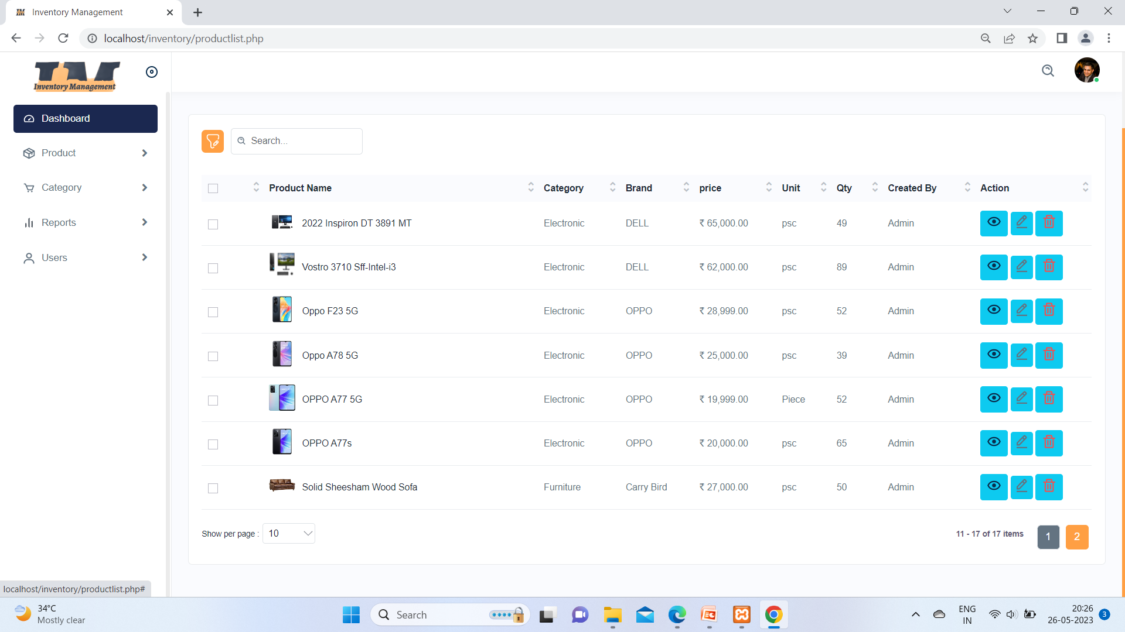

Slide 63
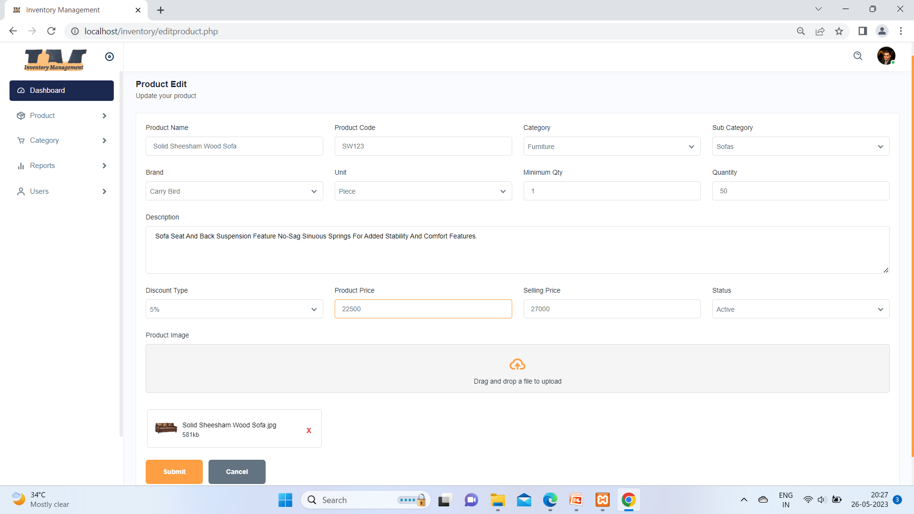
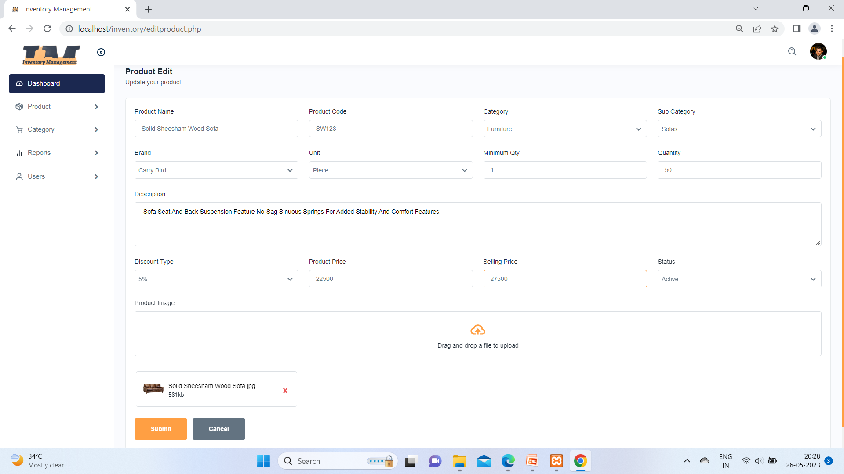

Slide 64
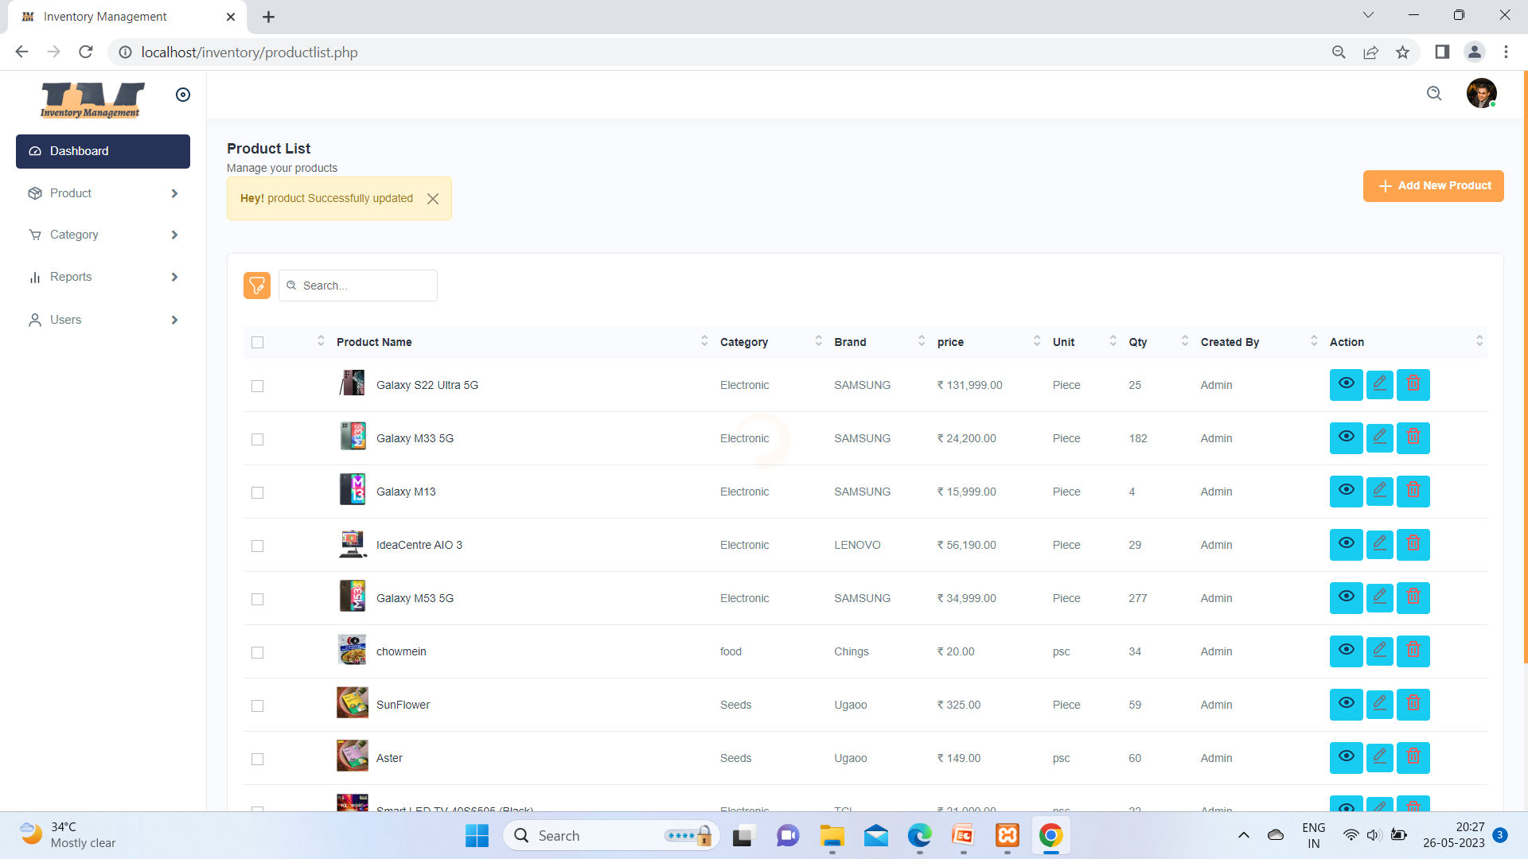


Slide 65
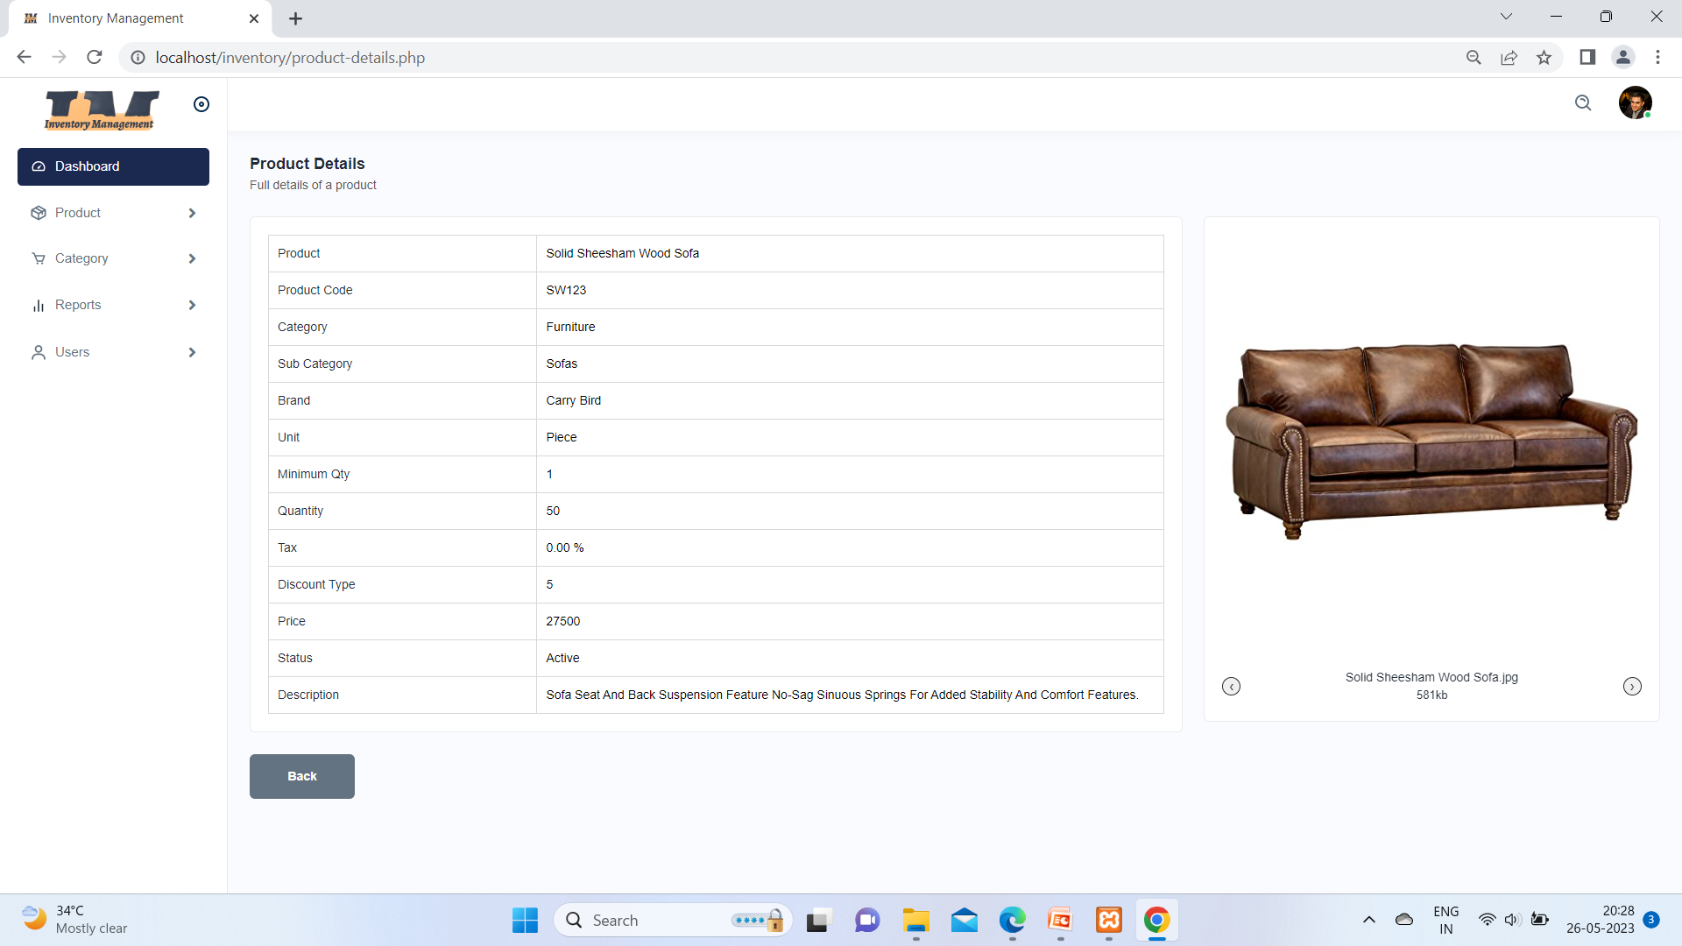

Slide 66
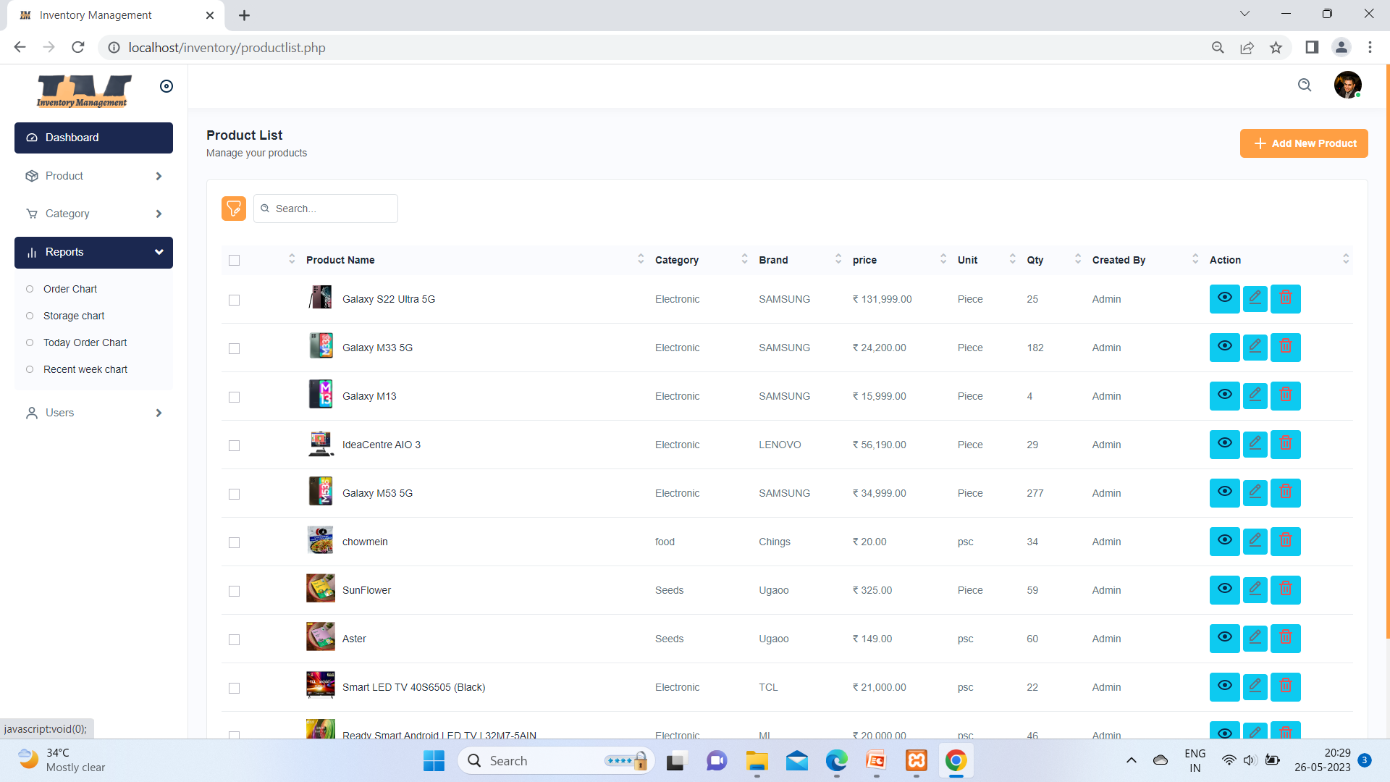


Slide 67
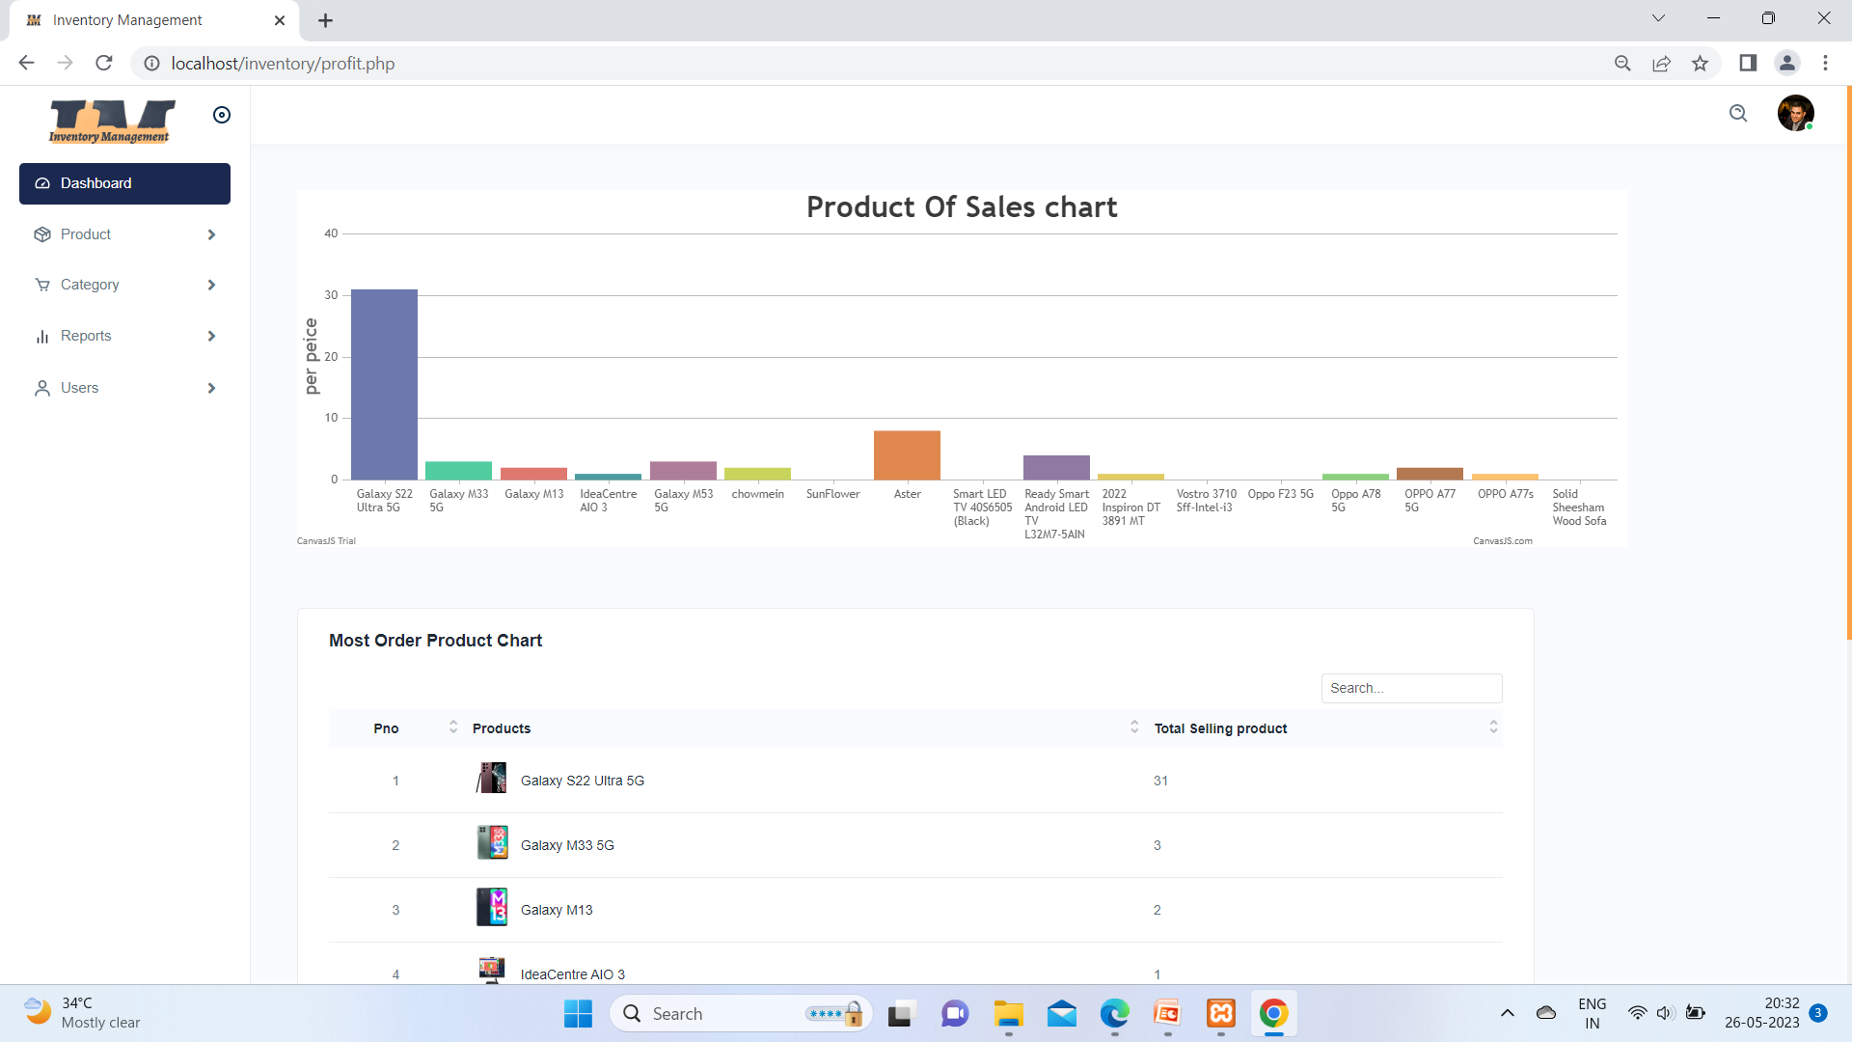

Slide 68
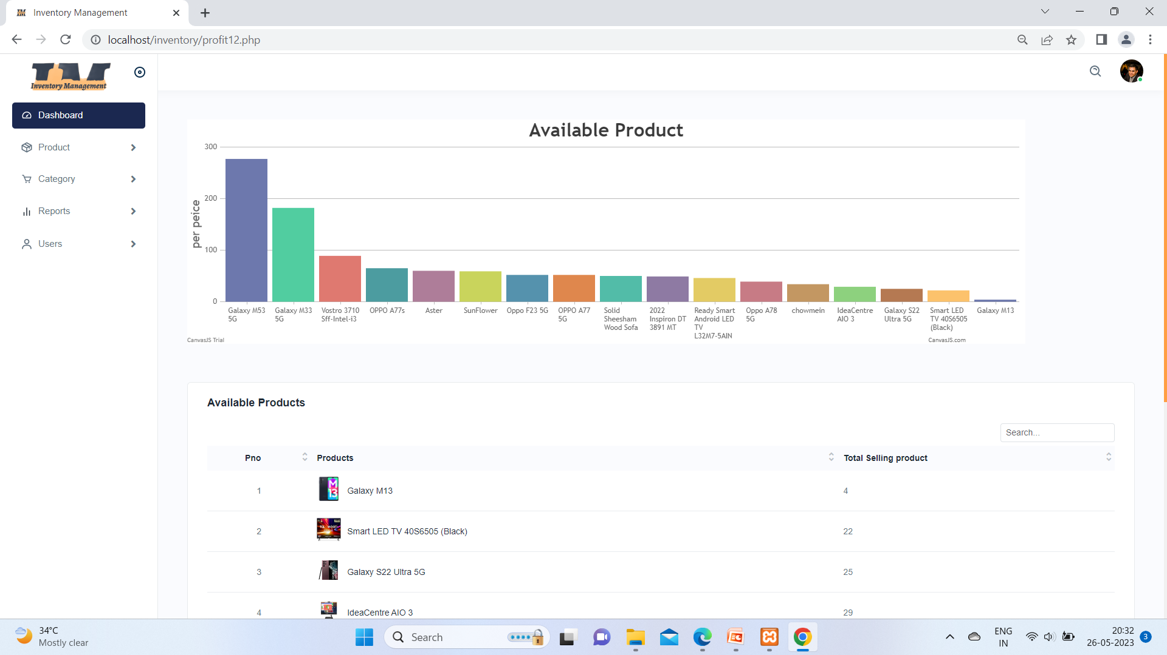

Slide 69
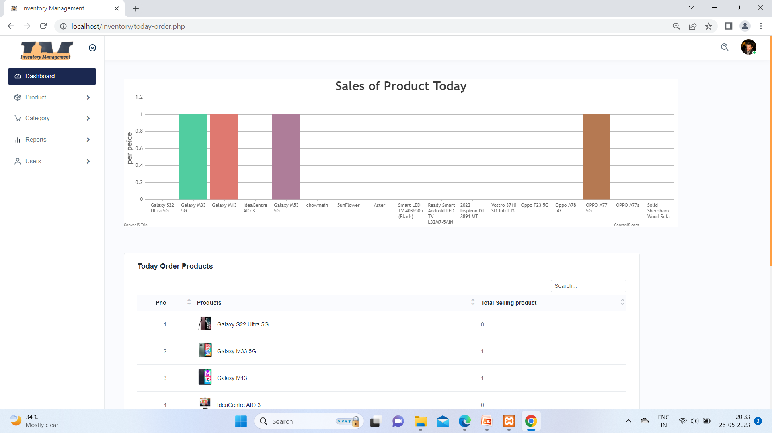

Slide 70
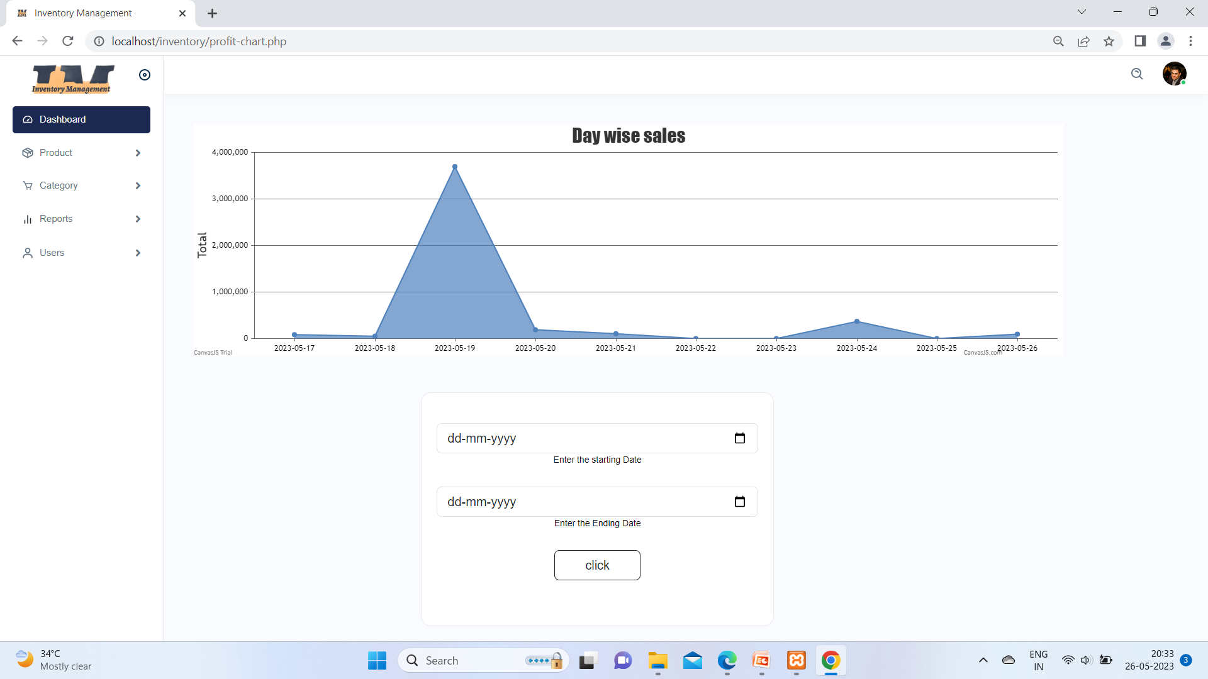

Slide 71


Slide 72
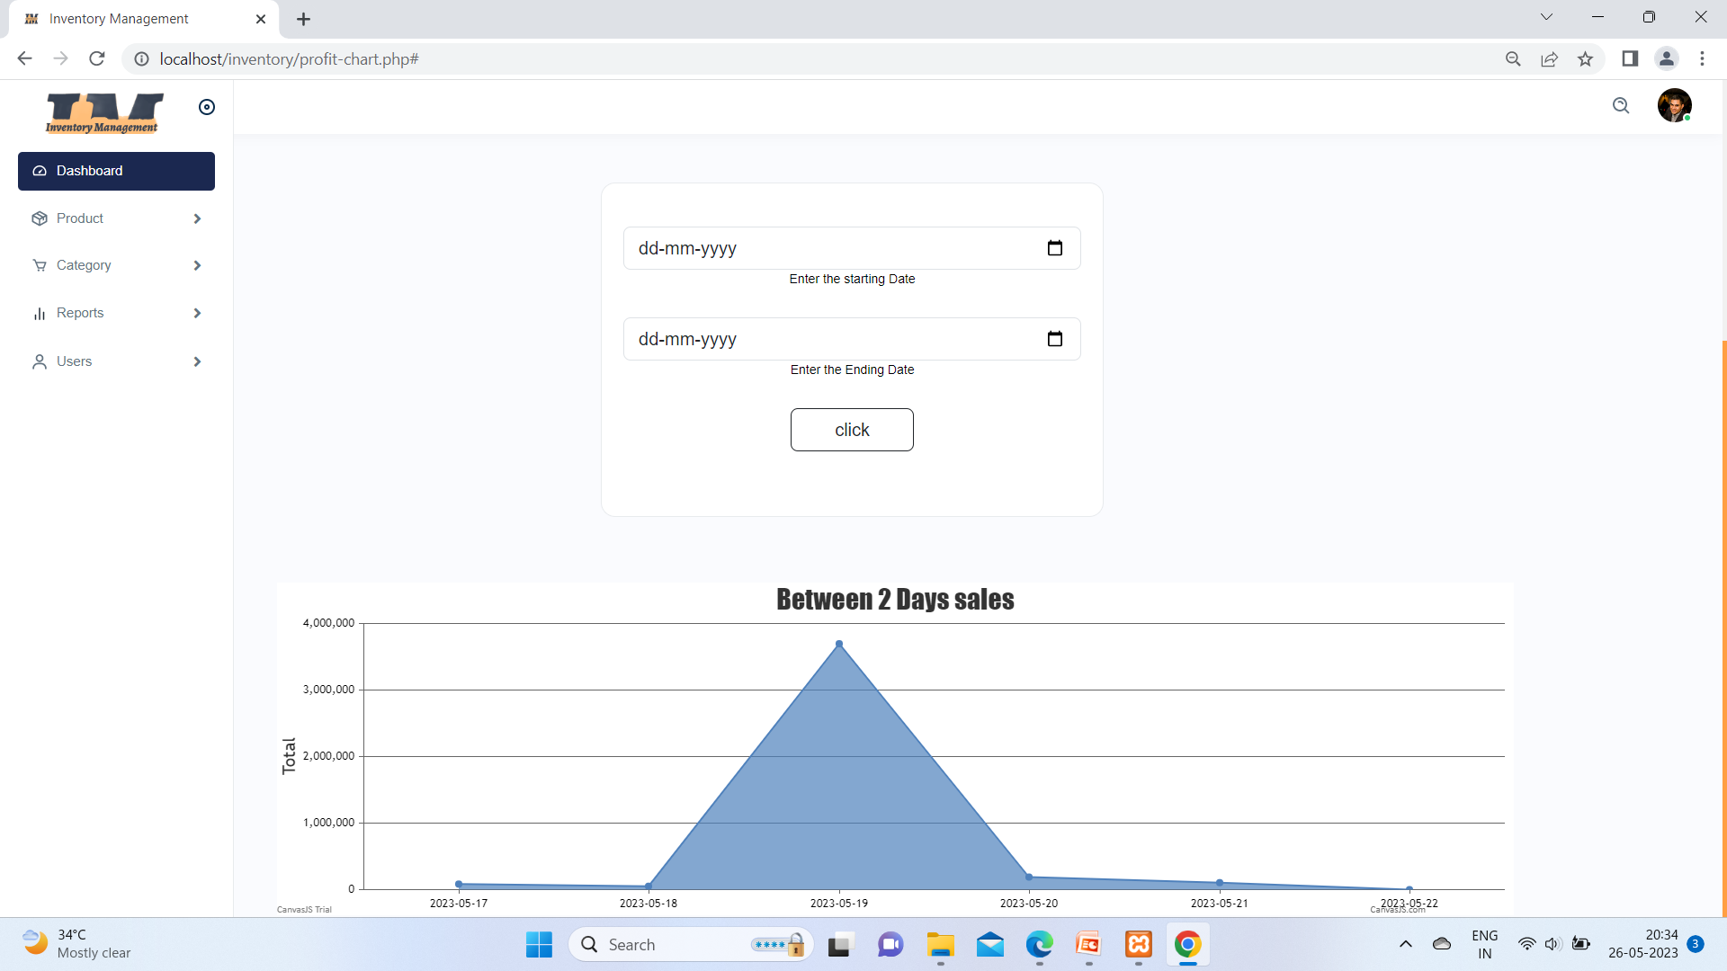

Slide 73
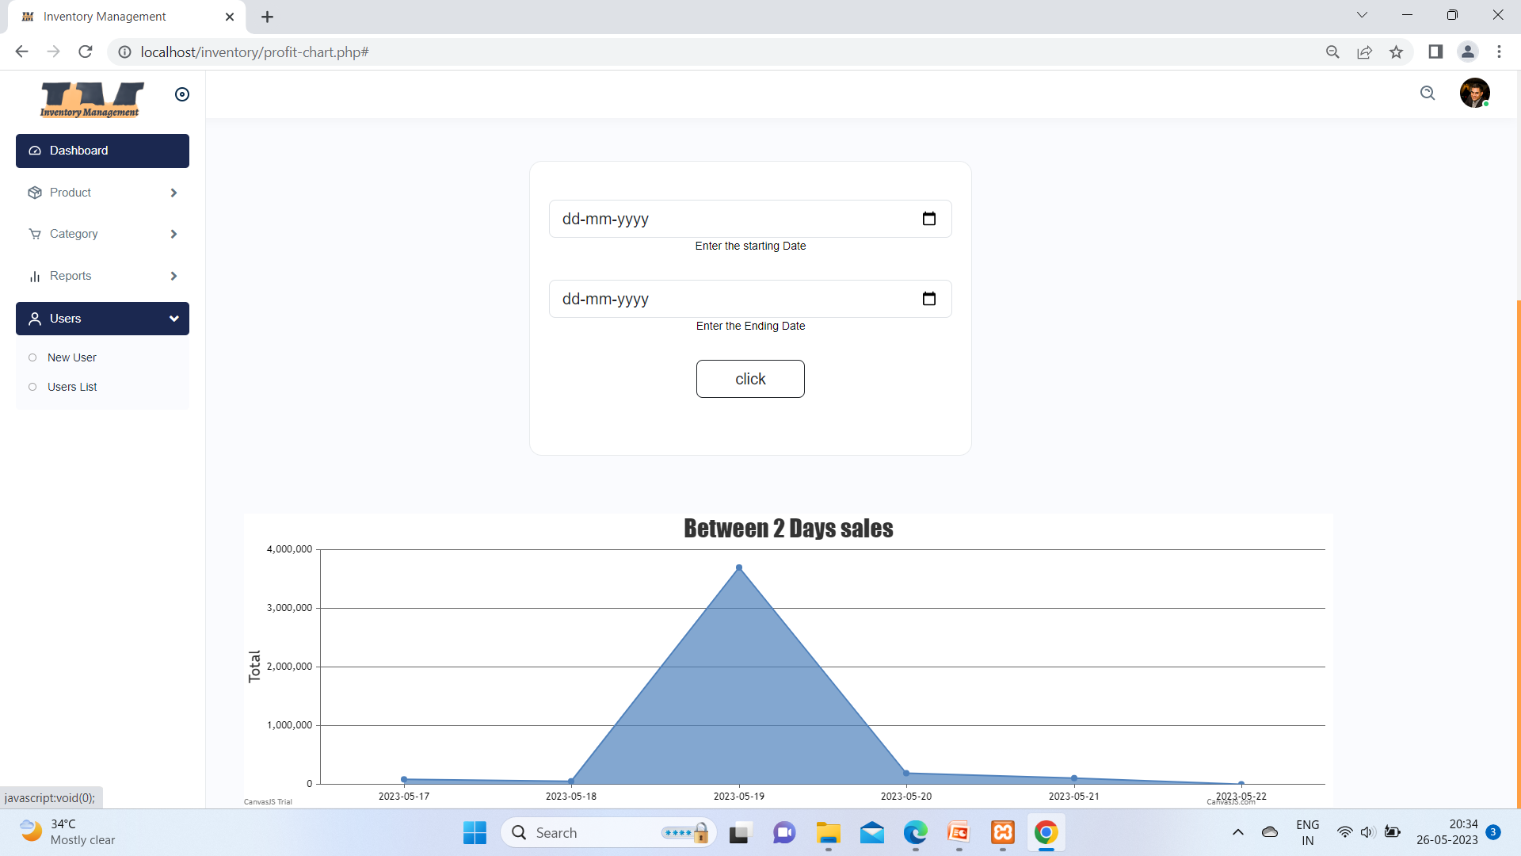

Slide 74


Slide 75


Slide 76


Slide 77
User Module

Slide 78


Slide 79



Slide 80


Slide 81


Slide 82


Slide 83



Slide 84




Slide 85




Slide 86


Slide 87


Slide 88


Slide 89


Slide 90


Slide 91



Slide 92



Slide 93


Slide 94


Slide 95


Slide 96



Slide 97


Slide 98


Slide 99


Slide 100


Slide 101


Slide 102


Slide 103


Slide 104
THANK YOU

